Slide 1
ELECTRICAL INSTALLATION(WIRING)
Ana Markovic

Slide 2
Some of the basic elements of electrical installations are:
conductors provodnici
insulators izolatori
cables kablovi
switches prekidači
sockets priključnice
light fittings sijalična grla
lamps svjetiljke
fuses osigurači
distribution boards (box) razvodne table
electrical panels (electric meters) elektricna brojila
plugs utikači
circuit brakers sklopke
Residual Current Circuit Breaker automatski prekidac rezidualne struje

Slide 3
Electrical wiring is an electrical installation of cabling and associated devices such as switches, distribution boards, sockets, and light fittings in a structure.
Allowable wire and cable types and sizes are specified according to the circuit operating voltage and electric current capability, with further restrictions on the environmental conditions, such as ambient temperature range, moisture levels, and exposure to sunlight and chemicals.

Slide 4
Materials for wiring interior electrical systems in buildings vary depending on:
Intended use and amount of power demand on the circuit
Type of occupancy and size of the building
National and local regulations
Environment in which the wiring must operate.
Homes typically have several kinds of home wiring, including electrical wiring for lighting and power distribution, permanently installed and portable appliances, telephone, heating or ventilation system control and computer networks.
AC power plugs and sockets connect electric equipment to the alternating current (AC) power supply in buildings and at other sites. Electrical plugs and sockets differ from one another in voltage and current rating, shape, size, and connector type
Plugs, wallsockets need to be installed throughout the house in locations where power will be required

Slide 5
Electric meters
First in the list of common electrical parts you see everyday is the Electric meter. It is used by the national electricity grid to measure the units of electrical energy used in your household circuits. Yeah, that’s how they find the amount you need to pay for your electricity bill per month.

Slide 6
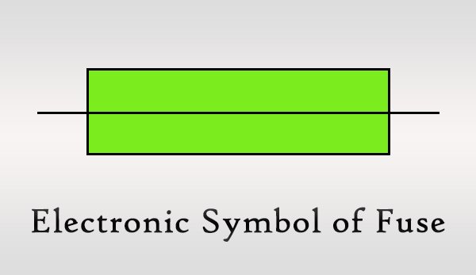
Fuses
A fuse is an electrical part which you can’t see as it’s always inside a plug or an electrical device such as TV.
Basically fuses are used to protect electrical appliances, parts and electronic components from potential damage due to a high current – Ampere – flowing in the circuit.

Slide 7
A miniature circuit breaker - it looks like a switch consisting various ampere values.
Circuit breakers function similar to fuses. In the event of an exceeding current flow than the rated ampere value, the switch opens and stops the current, instead of melting anything or dying forever.
The circuit can be connected again by closing the switch.

Slide 8
Distribution box
Distribution box is another easy to notice electrical part in your home. It consists 3 more electrical parts, namely,
Main Switch
Trip Switch
Circuit Breakers
As the name implies, Distribution Box simply distributes the electric supply to sections of the house.
These sections contain:
light circuits [Light Switches + Light Bulbs],
fan circuits [Fan Regulator + Fan]
plug socket circuits.

Slide 9
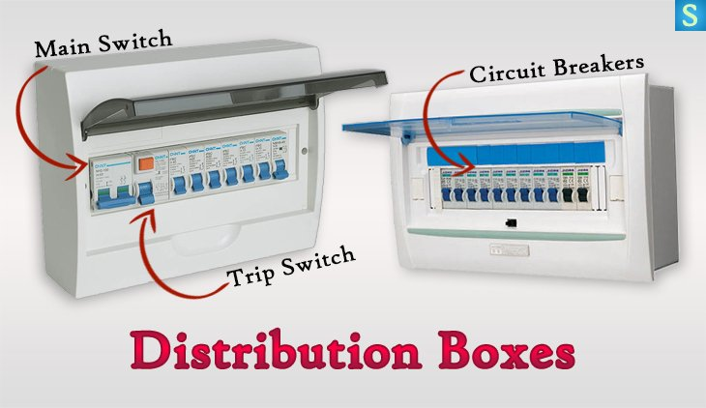

Slide 10
Main Switch
Every house or commercial building has a distribution box which is where the Main Switch is located.
It’s the first electrical part receiving the electricity from the electric meter inside your house. Therefore the Main Switch is the responsible part to take down the electricity throughout the house as required.
Often useful while upgrading house wiring and when thundering & lightning to disconnect the supply.
There are 2 wires inside the cable coming from the electric meter namely Live Wire and Neutral Wire. These 2 wires are then connected to the Main Switch. While the main switch is OFF the electric supply is stopped by disconnecting the two wires.

Slide 11
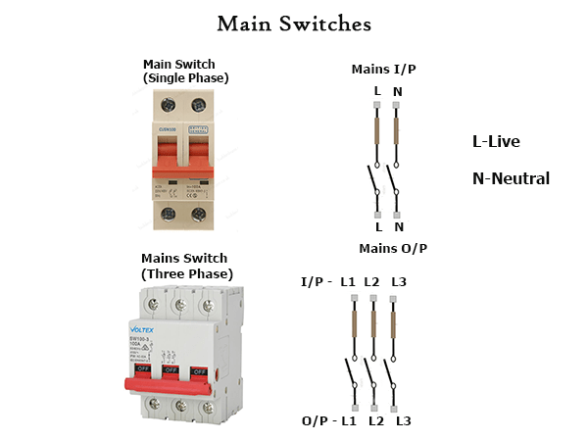

Slide 12
Trip Switch
Electric current coming from the Main Switch connects to the Trip Switch via Live & Neutral Wires.
If there is a fault in any of the circuits in the house this switch opens (Trip) automatically and disconnects the power supply.
Residual Current Circuit Breakers work by comparing the current entering the appliance via the live wire with the current leaving the appliance through the neutral wire.
RCCB consists of:
Primary coil
Secondary coil
Trip coil

Slide 13
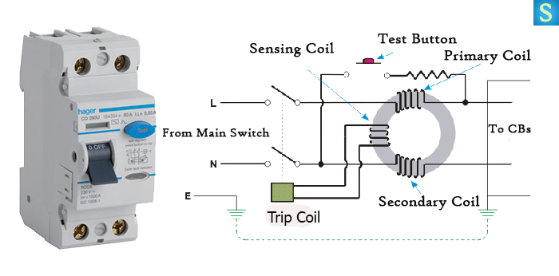

Slide 14
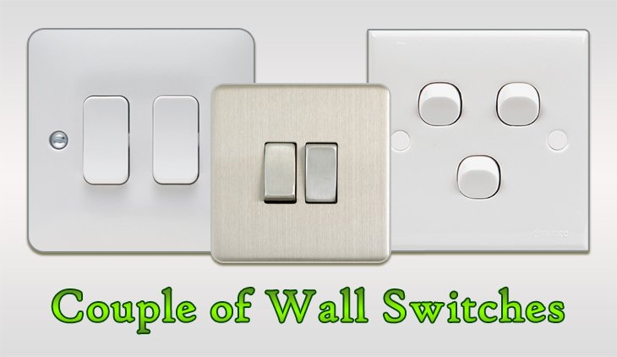
Wall Switches
Switches are used in light circuits and plug socket circuits to connect or disconnect the circuit according to the will of the individual.
There are different types of wall switches such as Push Button, Press Button... Then there are single, double, triple, quadruple as well as quintuple wall switches.

Slide 15
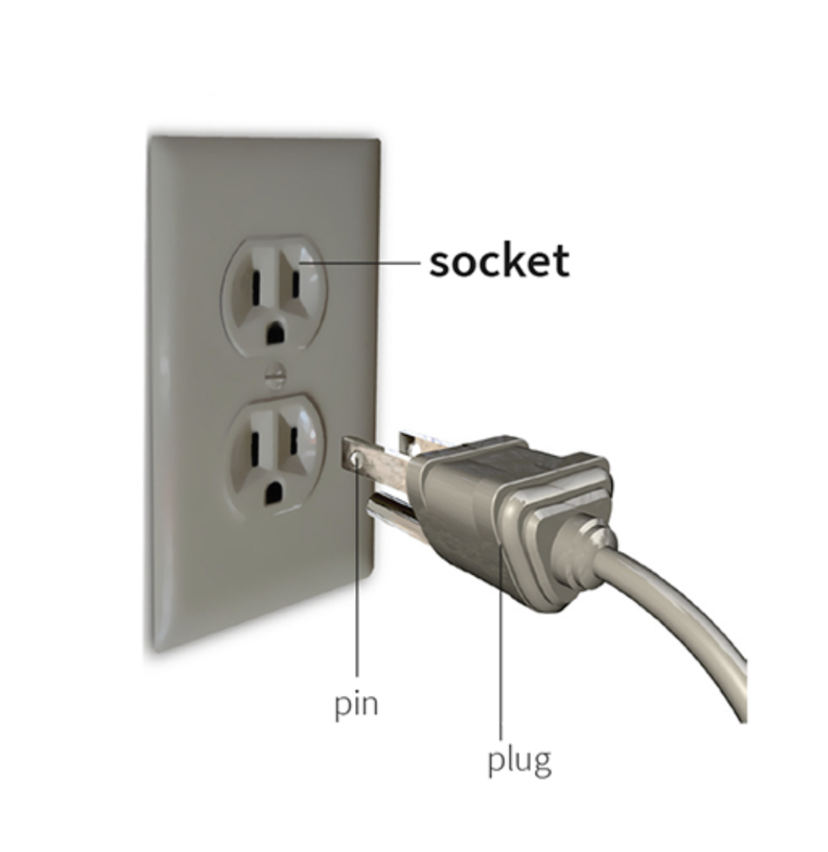
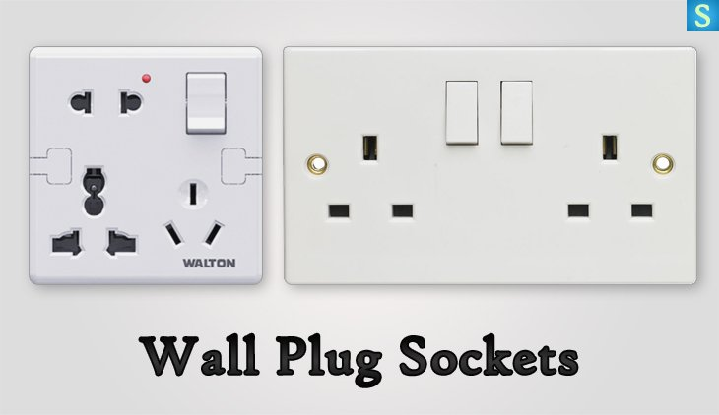
Plug sockets
Plug sockets are used to get electric supply for appliances like computers, electrical heaters, televisions, refrigerators and whatever electrical device you’ve been using.
There are different types of Plug Sockets based on pin type such as two-pin plugs and three-pin plugs where the 3rd pin is for Earth Wire.

Slide 16
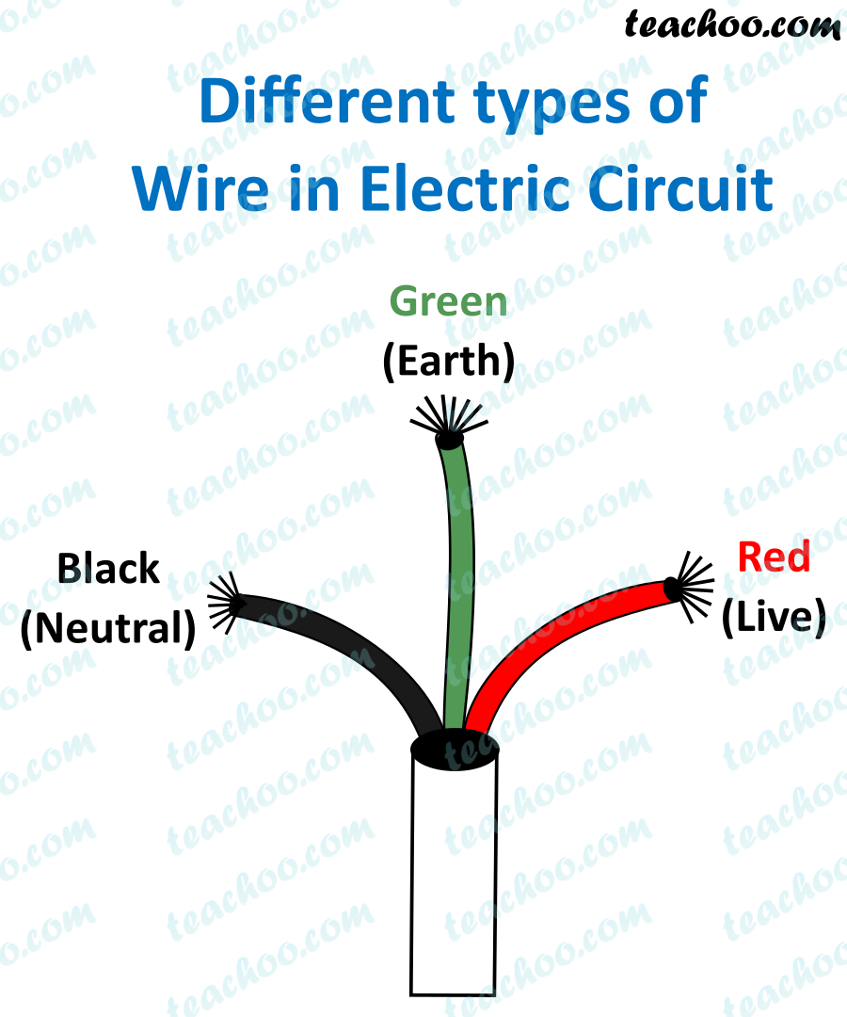
Electrical Wires & Cables
Electrical wires are used to transport electric current, from electric meter to distribution box to power outlets (Plug sockets), all things get the supply through various electrical wires.
There are 3 types of electrical wires
Live Wire
Neutral Wire
Earth Wire
Each of the above wires contain different color codes depending on the country
Wires with blue color are used for neutral connections, so those are the Neutral Wires. Then the wires with Brown,black or grey colors are used for live connections, so they are the Live Wires. If you see a Green or Yellow-Green wire, remember they are used for earth connections, which means those are the Earth Wires.

Slide 17
CABLES
Cables are the nervous system of all electrical installations, the method by which the electrical supply is carried. There are numerous types of cable, each designed for a particular job and environment. The amount of current a cable can carry depends on the cross-sectional area of its conductor. The larger the cross-sectional area, the more current it can take. It is, therefore, important to select the correct size for the job.

Slide 18
Cables have two components to them. One is the conductor itself. This is usually made of copper. The other part is insulation, usually made from PVC, which forms a sheath around the conductor. The insulation is required to:
prevent the conductors touching together; this could short the circuit and preventing it from working
prevent users of the circuit from coming into contact with the conductors and receiving an electric shock.
Modern non-metallic sheathed cables, consist of two to four wires covered with thermoplastic insulation, plus a bare wire for grounding (bonding), surrounded by a flexible plastic jacket.

Slide 19
All materials have resistance to electrical current. Some materials have a resistance so high it is virtually impossible for any current to pass through them. These are called insulators and include plastic, glass and wood. Other materials have a very low resistance and allow current to pass through them easily. These are called conductors. This is a general rule.

Slide 20
There are a number of factors that can reduce the amount of current a cable can carry. Among these are:
ambient temperature – the temperature of the surrounding air
presence of other conductors – cables produce heat when carrying current and when cables are bunched together their combined heat reduces current capacity
confined space – if a cable is buried in a wall or run through conduit, its current-generated heat cannot escape
the length of run – the longer the cable run the less current it can carry because, like water pressure in a pipe, the voltage is reduced the further you go from the power source

Slide 21
Conductors
The choice generally is between copper and aluminium. Copper has better conductivity for a given cross-sectional area and is preferable, but its cost has risen over the years. Aluminium conductors are now sometimes preferred for the medium and larger range of cables.
Conductor | Advantages | Disadvantages
Copper | Easier to joint and terminate Smaller cross-sectional area for given current rating | More costly heavier
Aluminium | Cheaper Lighter Not recommended for use in hazardous areas | Bulkier for given current rating

Slide 22
Electrical Earthing
The process of transferring the immediate discharge of the electrical energy directly to the earth by the help of the low resistance wire is known as THE ELECTRICAL EARTHING.
The electrical earthing is done by connecting the non-current carrying part of the equipment or neutral of supply system to the ground.
Mostly, the galvanised iron is used for the earthing. The earthing provides the simple path to the leakage current. The shortcircuit current of the equipment passes to the earth which has zero potential. Thus, protects the system and equipment from damage.

Slide 23
Types of Electrical Earthing
The electrical equipment mainly consists of two non-current carrying parts. These parts are neutral of the system or frame of the electrical equipment. From the earthing of these two non-current carrying parts of the electrical system earthing can be classified into two types.
Neutral Earthing
Equipment Earthing.

Slide 24
Neutral Earthing
In neutral earthing, the neutral of the system is directly connected to earth by the help of the GI wire.
The neutral earthing is also called the system earthing. Such type of earthing is mostly provided to the system which has star winding.
For example, the neutral earthing is provided in the generator, transformer, motor etc.

Slide 25
Equipment Earthing
Such type of earthing is provided to the electrical equipment. The non-current carrying part of the equipment like their metallic frame is connected to the earth by the help of the conducting wire.
If any fault occurs in the apparatus, the short-circuit current to pass the earth by the help of wire. Thus, protect the system from damage.

Slide 26
Importance of Earthing
The earthing is essential because of the following reasons
The earthing protects the personnel from the shortcircuit current.
The earthing provides the easiest path to the flow of shortcircuit current even after the failure of the insulation.
The earthing protects the apparatus and personnel from the high voltage surges and lightning discharge.
Earthing can be done by electrically connecting the respective parts in the installation to some system of electrical conductors or electrodes placed near the soil or below the ground level. The earthing mat or electrode under the ground level have flat iron riser through which all the non-current-carrying metallic parts of the equipment are connected.

Slide 27
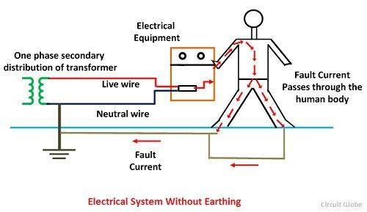
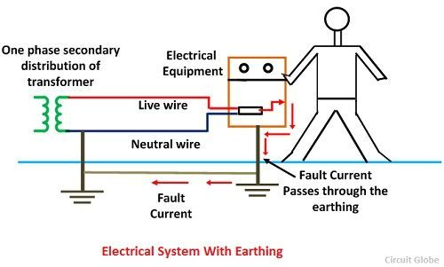
When the fault occurs the fault current from the equipment flows through the earthing system to the earth and thereby protect the equipment from the fault current. At the time of the fault, the earth mat conductors rise to the voltage which is equal to the resistance of the earth mat multiplied by a ground fault.

Slide 28
The contacting assembly is called earthing. The metallic conductors connecting the parts of the installation with the earthing are called electrical connection. The earthing and the earthing connection together called the earthing system.

