Slide 1
Past Perfect Simple and Continuous
2.2

Slide 4
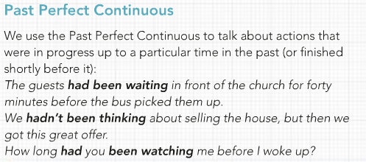

Slide 5
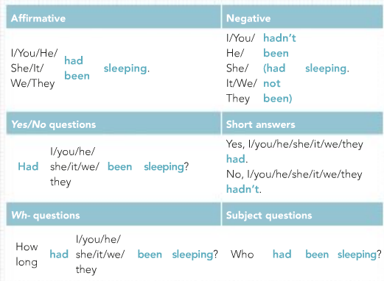
Form

