Slide 1
ZADACI iz adicionih formula i trigonometrijskih funkcija dvostrukog ugla i poluugla

Slide 2
Zadatak 1. Uprostiti izraz : $\frac{\sqrt{3}}{2}cosx−\frac{1}{2}sinx$
Rješenje:
$$\frac{\sqrt{3}}{2}cosx−\frac{1}{2}sinx=$$
$$\sin\left(60°−x\right)=sin⁡(\frac{π}{3}−x)$$
$$sin60°cosx−sinxcos60=$$
$$sin\left(α−β\right)=sinαcosβ−sinβcosα$$

Slide 3
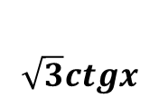
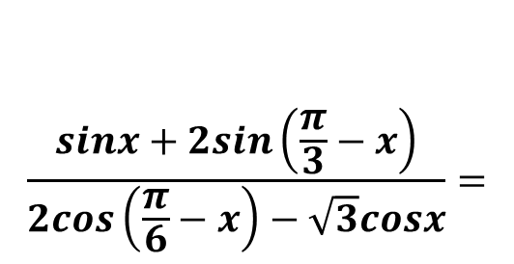
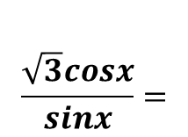
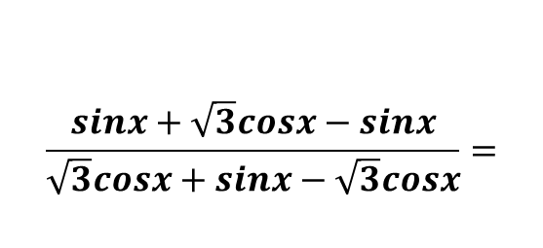
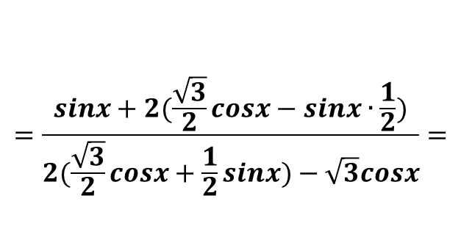
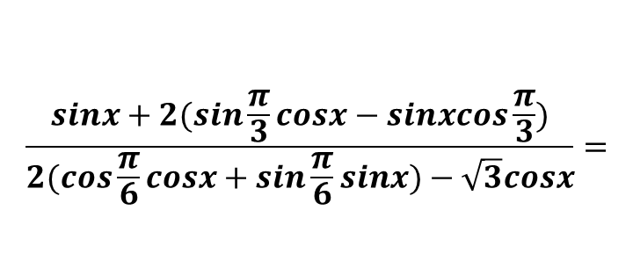
Zadatak 2. Uprostiti izraz : $\frac{cosx+2sin\left(\frac{π}{3}−x\right)}{2cos\left(\frac{π}{6}−x\right)−\sqrt{3}cosx}$
Rješenje:
$$\frac{sinx+2sin\left(\frac{π}{3}−x\right)}{2cos\left(\frac{π}{6}−x\right)−\sqrt{3}cosx}=$$
$$sin\left(α−β\right)=sinαcosβ−sinβcosα$$
$$cos⁡(α−β)=cosαcosβ+sinαsinβ$$
$$\frac{sinx+2(sin\frac{π}{3}cosx−sinxcos\frac{π}{3})}{2(cos\frac{π}{6}cosx+sin\frac{π}{6}sinx)−\sqrt{3}cosx}=$$
$$=\frac{sinx+2(\frac{\sqrt{3}}{2}cosx−sinx∙\frac{1}{2})}{2(\frac{\sqrt{3}}{2}cosx+\frac{1}{2}sinx)−\sqrt{3}cosx}=$$
$$\frac{sinx+\sqrt{3}cosx−sinx}{\sqrt{3}cosx+sinx−\sqrt{3}cosx}=$$
$$\frac{\sqrt{3}cosx}{sinx}=$$
$$\sqrt{3}ctgx$$

Slide 4
Zadatak 3. Izračunati : a)${\left(sin15°−cos15°\right)}^{2}$ b)$2\cos^{2}\frac{π}{8}−1$
Rješenje:
$$sin2α=2sinαcosα$$
a) ${\left(sin15°−cos15°\right)}^{2}=$
$$\sin^{2}15°−2sin15°cos15°+\cos^{2}15°=$$
$$=1−sin30°=1−\frac{1}{2}=\frac{1}{2}$$
$$2\cos^{2}\frac{α}{2}=1+cosα$$
$$1+cos\frac{π}{4}−1=cos\frac{π}{4}=\frac{\sqrt{2}}{2}$$
b)$2\cos^{2}\frac{π}{8}−1=$

Slide 5
Zadatak 4. Izraziti $sin3α$ preko $sinα$
Rješenje:
$$sin⁡(α+β)=sinαcosβ+sinβcosα$$
$$sin2α=2sinαcosα$$
$$cos2α=\cos^{2}α−\sin^{2}α$$
$$\sin^{2}α+\cos^{2}α=1$$
$$sin3α=\sin\left(2α+α\right)=$$
$$sin2αcosα+sinαcos2α=$$
$$=2sinαcosαcosα+sinα\left(\cos^{2}α−\sin^{2}α\right)=$$
$$2sinα\cos^{2}α+sinα\cos^{2}α−\sin^{3}α=$$
$$=3sinα\cos^{2}α−\sin^{3}α=$$
$$3sinα\left(1−\sin^{2}α\right)−\sin^{3}α=$$
$$3sinα−3\sin^{3}α−\sin^{3}α=$$
$$=3sinα−4\sin^{3}α$$

Slide 6
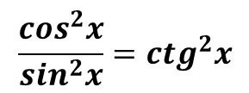
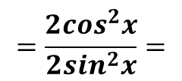
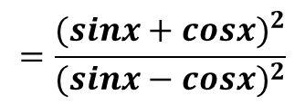
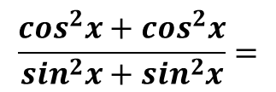
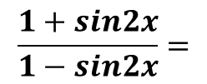
Zadatak 5. Uprostiti izraze : a)$\frac{1+cos2x}{1−cos2x}$ b) $\frac{1+sin2x}{1−sin2x}$
Rješenje:
$$cos2α=\cos^{2}α−\sin^{2}α$$
$a) \frac{1+cos2x}{1−cos2x}=$
$$\frac{1+\cos^{2}x−\sin^{2}x}{1−(\cos^{2}x−\sin^{2}x)}=$$
$$\frac{1+\cos^{2}x−\sin^{2}x}{1−\cos^{2}x+\sin^{2}x}=$$
$$\frac{\cos^{2}x+\cos^{2}x}{\sin^{2}x+\sin^{2}x}=$$
$$=\frac{2\cos^{2}x}{2\sin^{2}x}=$$
$$\frac{\cos^{2}x}{\sin^{2}x}={ctg}^{2}x$$
$$sin2α=2sinαcosα$$
$$\frac{1+sin2x}{1−sin2x}=$$
$$\frac{1+2sinxcosx}{1−2sinxcosx}=$$
$$\frac{\sin^{2}x+\cos^{2}x+2sinxcosx}{\sin^{2}x+\cos^{2}x−2sinxcosx}=$$
b)
$$=\frac{{(sinx+cosx)}^{2}}{{(sinx−cosx)}^{2}}$$

Slide 7
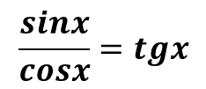
Zadatak 6. Uprostiti izraz : $\frac{1−cos2x+sin2x}{1+cos2x+sin2x}$
Rješenje:
$$\frac{1−cos2x+sin2x}{1+cos2x+sin2x}=$$
$$\frac{2\sin^{2}x+2sinxcosx}{2\cos^{2}x+2sinxcosx}=$$
$$\frac{2sinx(sinx+cosx)}{2cosx(cosx+sinx)}=$$
$$\frac{sinx}{cosx}=tgx$$
$$2\sin^{2}α=1−cos2α$$
$$2\cos^{2}α=1+cos2α$$
$$sin2α=2sinαcosα$$

