Slide 1
Grade: 2 Classes: R2A, R2B REVISION

Slide 2
Organizacija rada
Udžbenik: “Focus 2”, Paerson, Longman
YouTube kanal škole
Školski sajt: www. elektropg.online (Kurs pod nazivom “Drugi razred R2a,R2b)

Slide 3
Tenses

Slide 4
drank
drinks
drunk
drink
Nancy _______ milk every morning.
drinks

Slide 5
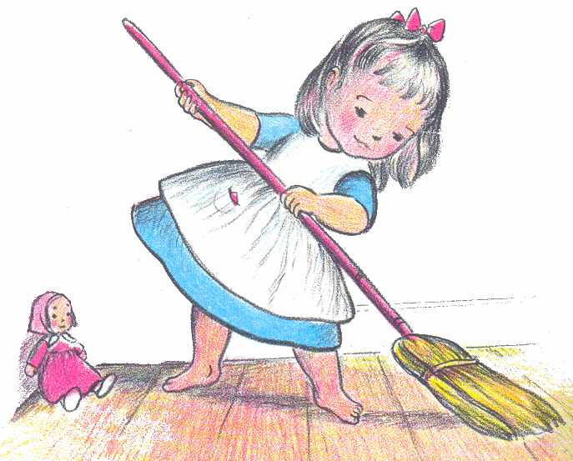
sweep
sweeped
swept
sweeps
Susan _______ the floor an hour ago.
swept

Slide 6
dreamt
dreams
has dreamt
is dreaming
Valerie _____________ about being a
painter at the moment.
is dreaming

Slide 7
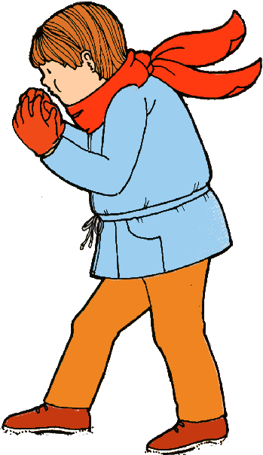
has caught
caught
catches
is catching
What’s wrong with Ron?
He ____________ a cold.
has caught

Slide 8
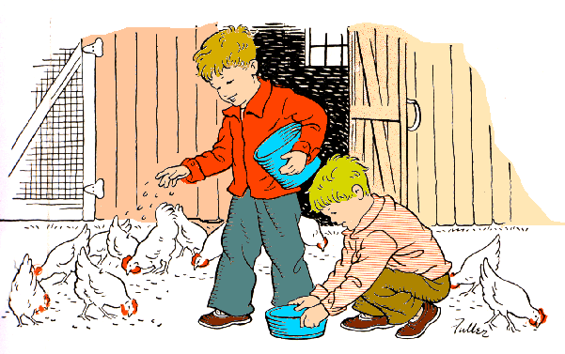
fed
are feeding
have fed
feeds
Your brothers _____________ the
hens now.
are feeding

Slide 9
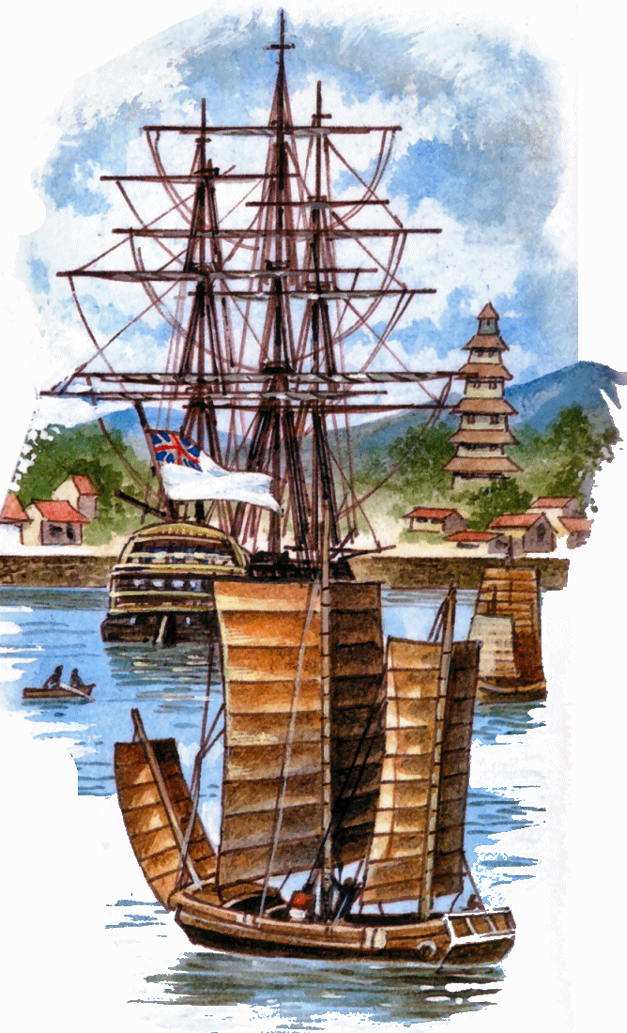
are standing
have arrived
arrives
arrived
Ships ________ to the port yesterday.
arrived

Slide 10
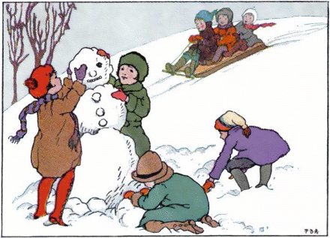
haven’t made
don’t make
didn’t make
are not making
Children __________________ a
snowman.
haven’t made

Slide 11
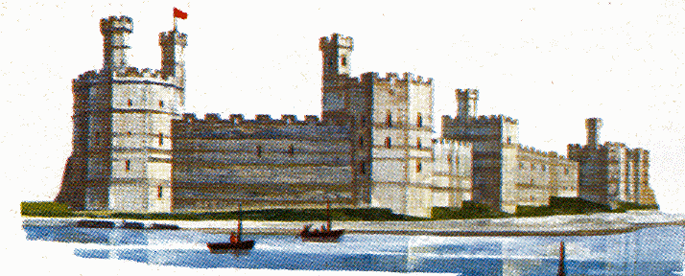
been
was
is
are
The fortress ____ on the bank of the
river.
is

Slide 12
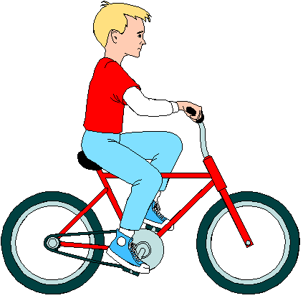
am riding
rode
ride
ridden
I ______ a bike when I was a child.
rode

Slide 13
Students’ books
Page 4, exercise 7
Page 5, exercise 8
Page 6, exercises 3 and 4

Slide 14
Further practice
Focus 2 Workbook, pages 4 and 5

Slide 15
Link za video lekciju: https://www.youtube.com/watch?v=N9PbvtBCgsk

