Slide 1
COMPARISON OF ADJECTIVES
Teacher Elida

Slide 2
COMPARISON IS USED
WHEN WE COMPARE TWO PEOPLE OR THINGS.
THE EASIEST RULE IS: ADD THE ENDING –ER TO ONE-SYLLABLE WORDS AND TO TWO SYLLABLE WORDS ENDING IN –Y, E.G.
FAST – FASTER
EASY – EASIER
BIG - BIGGER

Slide 3
IN SENTENCES
Comparisons involve
at least two people or two things. We use than before the second
part of the comparison:
Example 1
Peter is taller than Jim
Example 2
This car is faster than that one.

Slide 4
LONG ADJECTIVES
Put more (adverb of degree)
in front of longer words, e.g.
¡difficult – more difficult
¡interesting – more interesting
¡beautiful – more beautiful
In sentences:
¡Mary is more beautiful than
Sally.
¡This book is more interesting than
that one.

Slide 5
SUPERLATIVE
The superlative of a
word is used to compare three or more things/people and to pick out one
thing/person as more “X” than all the others.
¡Everest is the
highest mountain in the
world.
¡It is also the
most famous mountain in the
world.

Slide 6
REMEMBER
adjectives are compared like this:
¡big – bigger – the biggest
¡easy – easier – the easiest
¡interesting – more
interesting – the
most interesting
¡famous – more
famous – the
most famous

Slide 7
Some adjectives do not normally have comparative and superlative forms:
absent,
equal,
left,
opposite,
right,
single.
WITHOUT COMPARATIVE FORMS

Slide 8
IRREGULARITIES
Certain adjectives have separate forms for comparative and superlative, or are in some other way
“irregular”:
good – better – the best (the same is used for ‘well’, meaning ‘in good health’)
bad, ill, evil
worse – the worst
many, much – more – the most

Slide 9
DIFFERENT FORMS
Some adjectives form
their comparative and superlative degrees in two ways:
old – older/elder –the oldest/eldest
far – farther/further– the farthest/furthest
late – later – the latest/last
near – nearer – the nearest/next
I

Slide 10
DON'T FORGET
As…as…
John is as tall as Bob.
Your house is as large as mine.
Not so/as.. as.
This book is not so interesting as that one.
The tree is not as tall as the building over
there.

Slide 11
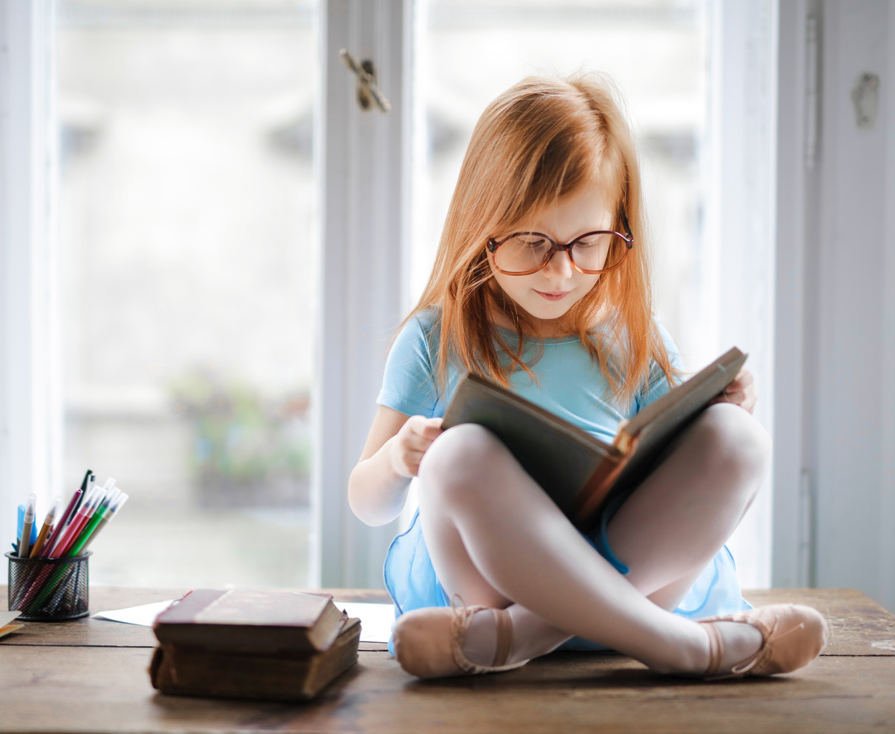
IN IDIOMS
.
As good as gold
As poor as a church mouse
As brave as a lion
As black as coal
As blind as a bat
As pale as a ghost
As cool as a cucumber
As fierce as a tiger
As light as a feather
As white as a sheet
As white as snow
As wise as an owl

Slide 12
THANK YOU :)

