Slide 1
INFORMATIKA
JU ETŠ „VASO ALIGRUDIĆ“, Podgorica
PREDMETNI NASTAVNIK: SPASOJE PAPIĆ

Slide 2
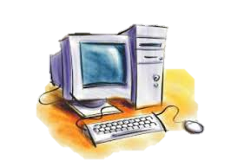
ŠTA JE INFORMATIKA ?
Informatika je nauka koja se bavi prikupljanjem, obradom, čuvanjem i prezentovanjem informacija korisniku.
Notes:
Notes to presenter:
Description of what you learned in your own words on one side.
Include information about the topic
Details about the topic will also be helpful here.
Tell the story of your learning experience. Just like a story there should always be a beginning, middle and an end.
On the other side, you can add a graphic that provides evidence of what you learned.
Feel free to use more than one slide to reflect upon your process. It also helps to add some video of your process.

Slide 3
PREDMET IZUČAVANJA INFORMATIKE
PODACI
INFORMACIJE
Notes:
Notes to presenter:
Description of what you learned in your own words on one side.
Include information about the topic
Details about the topic will also be helpful here.
Tell the story of your learning experience. Just like a story there should always be a beginning, middle and an end.
On the other side, you can add a graphic that provides evidence of what you learned.
Feel free to use more than one slide to reflect upon your process. It also helps to add some video of your process.

Slide 4
PODACI
Podaci su registrovane činjenice, oznake ili zapažanja nastala u toku nekog procesa.
Pojam podataka vezan je za fizičke simbole koji mogu da se bilježe (registruju), čuvaju, prenose i obrađuju.
Podatak doslovno označava činjenicu, koja može biti u obliku broja, teksta ili slike i koja se kao takva pamti.
Npr. visina Mosta na Tari 170 m to je podatak.
Notes:
Notes to presenter:
Description of what you learned in your own words on one side.
Include information about the topic
Details about the topic will also be helpful here.
Tell the story of your learning experience. Just like a story there should always be a beginning, middle and an end.
On the other side, you can add a graphic that provides evidence of what you learned.
Feel free to use more than one slide to reflect upon your process. It also helps to add some video of your process.

Slide 5
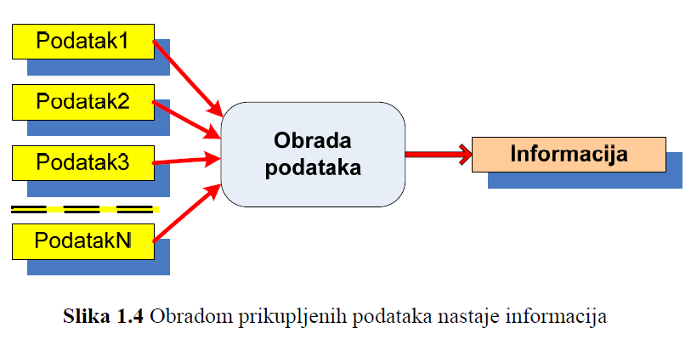
PODACI
Notes:
Notes to presenter:
Description of what you learned in your own words on one side.
Include information about the topic
Details about the topic will also be helpful here.
Tell the story of your learning experience. Just like a story there should always be a beginning, middle and an end.
On the other side, you can add a graphic that provides evidence of what you learned.
Feel free to use more than one slide to reflect upon your process. It also helps to add some video of your process.

Slide 6
INFORMACIJA
Informacija je podatak koji ima značenje u nekom kontekstu.
Informacije su podaci koji su obrađeni da bi imali određeno značenje i bili korisni.
Informacija je skup činjenica tako obrađenih i organizovanih da predstavljaju neko obavještenje.
Notes:
Notes to presenter:
Description of what you learned in your own words on one side.
Include information about the topic
Details about the topic will also be helpful here.
Tell the story of your learning experience. Just like a story there should always be a beginning, middle and an end.
On the other side, you can add a graphic that provides evidence of what you learned.
Feel free to use more than one slide to reflect upon your process. It also helps to add some video of your process.

Slide 7
ISTORIJAT RAZVOJA RAČUNARA
Premehanički period
Mehanički period
Elektromehanički period
Elektronski period
Revolucija……
Notes:
Notes to presenter:
Description of what you learned in your own words on one side.
Include information about the topic
Details about the topic will also be helpful here.
Tell the story of your learning experience. Just like a story there should always be a beginning, middle and an end.
On the other side, you can add a graphic that provides evidence of what you learned.
Feel free to use more than one slide to reflect upon your process. It also helps to add some video of your process.

Slide 8
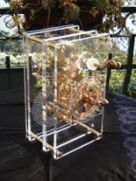
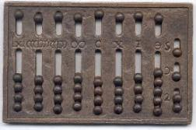
ISTORIJAT RAZVOJA RAČUNARA
PREMEHANIČKI PERIOD
U Africi je pronađena kost na kojoj su zarezima obilježeni brojevi….
Razvojem trgovine raste i potreba za računanjem…
Abakus
Antikitera
Notes:
Notes to presenter:
Description of what you learned in your own words on one side.
Include information about the topic
Details about the topic will also be helpful here.
Tell the story of your learning experience. Just like a story there should always be a beginning, middle and an end.
On the other side, you can add a graphic that provides evidence of what you learned.
Feel free to use more than one slide to reflect upon your process. It also helps to add some video of your process.

Slide 9
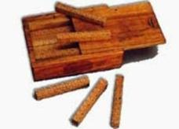
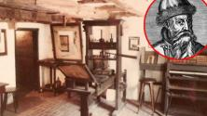
ISTORIJAT RAZVOJA RAČUNARA
PREMEHANIČKI PERIOD
Arapski brojevi – Al horezmi
U Evropu donio Leonardo Fibonaci
Štamparska presa – Gutenberg
Neperove kosti
Klizajući lenjir
Notes:
Notes to presenter:
Description of what you learned in your own words on one side.
Include information about the topic
Details about the topic will also be helpful here.
Tell the story of your learning experience. Just like a story there should always be a beginning, middle and an end.
On the other side, you can add a graphic that provides evidence of what you learned.
Feel free to use more than one slide to reflect upon your process. It also helps to add some video of your process.

Slide 10
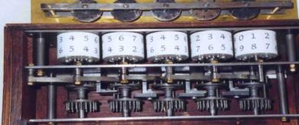
ISTORIJAT RAZVOJA RAČUNARA
MEHANIČKI PERIOD
Prve mašine za računanje je napravio Blez Paskal i zvale su se „paskaline“.
Sastojala se od niza brojčanika koji su se pomjerali uz pomoć točkića i pera. Ova mašina je mogla da sabira i oduzima osmocifrene brojeve.
Notes:
Notes to presenter:
Description of what you learned in your own words on one side.
Include information about the topic
Details about the topic will also be helpful here.
Tell the story of your learning experience. Just like a story there should always be a beginning, middle and an end.
On the other side, you can add a graphic that provides evidence of what you learned.
Feel free to use more than one slide to reflect upon your process. It also helps to add some video of your process.

Slide 11
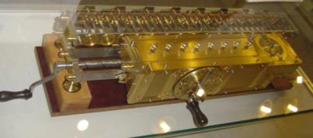
ISTORIJAT RAZVOJA RAČUNARA
MEHANIČKI PERIOD
Njemački matematičar i filozof Gotfrid Vilhelm fon Lajbnic je unaprijedio Paskalovu računsku mašinu 1673. godine. Koristila je zupčanike.
Njegov koncept je mogao da sabira, oduzima, množi i dijeli brojeve koji su imali između 5 i 12 cifara.
Notes:
Notes to presenter:
Description of what you learned in your own words on one side.
Include information about the topic
Details about the topic will also be helpful here.
Tell the story of your learning experience. Just like a story there should always be a beginning, middle and an end.
On the other side, you can add a graphic that provides evidence of what you learned.
Feel free to use more than one slide to reflect upon your process. It also helps to add some video of your process.

Slide 12
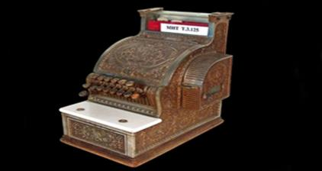
ISTORIJAT RAZVOJA RAČUNARA
MEHANIČKI PERIOD
Tomas de Kulmar – aritmometar
Barouzova računska mašina – umjesto zupčanika su tasteri.
Notes:
Notes to presenter:
Description of what you learned in your own words on one side.
Include information about the topic
Details about the topic will also be helpful here.
Tell the story of your learning experience. Just like a story there should always be a beginning, middle and an end.
On the other side, you can add a graphic that provides evidence of what you learned.
Feel free to use more than one slide to reflect upon your process. It also helps to add some video of your process.

Slide 13
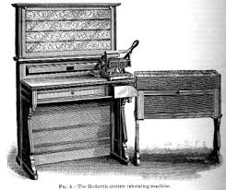
ISTORIJAT RAZVOJA RAČUNARA
ELEKTROMEHANIČKI PERIOD
Ljudi počinju da koriste električnu energiju
Koristi se kombinacija elektromagnetne komponente sa mehaničkim napravama.
Računske mašine se prave od prekidača i releja.
Herman Holerit – mašina za automatsku obradu rezultata popisa stanovništa.
Notes:
Notes to presenter:
Description of what you learned in your own words on one side.
Include information about the topic
Details about the topic will also be helpful here.
Tell the story of your learning experience. Just like a story there should always be a beginning, middle and an end.
On the other side, you can add a graphic that provides evidence of what you learned.
Feel free to use more than one slide to reflect upon your process. It also helps to add some video of your process.

Slide 14
ISTORIJAT RAZVOJA RAČUNARA
ELEKTROMEHANIČKI PERIOD
Važno otkriće za projektovanje savremenih računara je bio koncept binarnog sistema postavljenog od strane irskog naučnika Džordža Bula (Bulova algebra).
Godine 1884. Amerikanac Herman Holerit je patentirao mašinu za tabeliranje pomoću bušenih kartica čime je omogućeno brzo očitavanje podataka. Holerit je zatim osnovao kompaniju koja je bila preteča IBM-a.
Notes:
Notes to presenter:
Description of what you learned in your own words on one side.
Include information about the topic
Details about the topic will also be helpful here.
Tell the story of your learning experience. Just like a story there should always be a beginning, middle and an end.
On the other side, you can add a graphic that provides evidence of what you learned.
Feel free to use more than one slide to reflect upon your process. It also helps to add some video of your process.

Slide 15
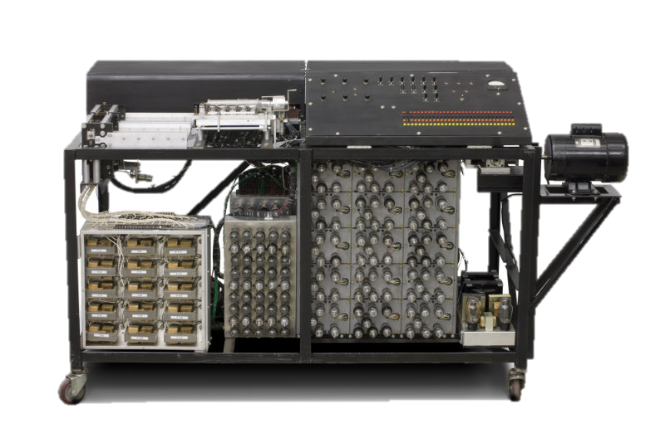
ISTORIJAT RAZVOJA RAČUNARA
ELEKTRONSKI PERIOD
Prva potpuno elektronska računska mašina je bila ABC autora Beri i Atanasf.
Napravljena je da rješava sistem linearnih jednačina.
Nije se mogla programirati.
Mnogo vakumskih cijevi.
Notes:
Notes to presenter:
Description of what you learned in your own words on one side.
Include information about the topic
Details about the topic will also be helpful here.
Tell the story of your learning experience. Just like a story there should always be a beginning, middle and an end.
On the other side, you can add a graphic that provides evidence of what you learned.
Feel free to use more than one slide to reflect upon your process. It also helps to add some video of your process.

Slide 16
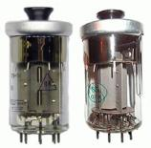
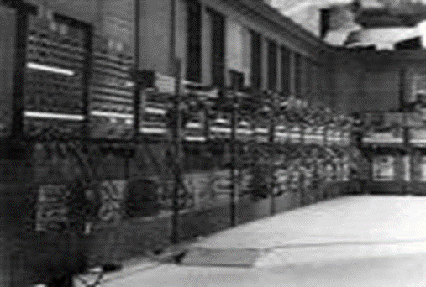
ISTORIJAT RAZVOJA RAČUNARA
Računari 1. generacije (1951-1958)
1944: Mark 1 - prvi elektromehanički računar opšte namjene kojeg je razvio profesor sa Harvarda, Howard Aiken, proizvod je IBM-a.
1944: ENIAC - 30 tona težak, 18.000 elektronskih cijevi.
1950: UNIVAC I - prvi komercijalni računar opšte namjene.
Opšte karakteristike:
Elektronske vakum cijevi.
Mašinski jezik (0 i 1).
Magnetna primarna memorija.
Unos programa i podataka preko bušenih kartica.
Sve potrebne radnje je uglavnom izvršavao sam operater.
Notes:
Notes to presenter:
Description of what you learned in your own words on one side.
Include information about the topic
Details about the topic will also be helpful here.
Tell the story of your learning experience. Just like a story there should always be a beginning, middle and an end.
On the other side, you can add a graphic that provides evidence of what you learned.
Feel free to use more than one slide to reflect upon your process. It also helps to add some video of your process.

Slide 17
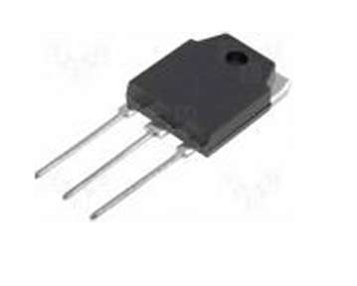
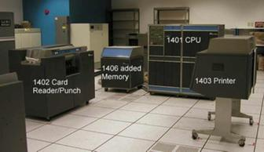
ISTORIJAT RAZVOJA RAČUNARA
Računari 2. generacije (1959-1963)
Osnovne karakteristike:
Tranzistori.
Početak jezika višeg nivoa: Fortran i Cobol.
Magnetna primarna memorija.
Magnetni diskovi i trake za sekundarnu memoriju.
Tipični prim.eri: Philco Transac S-2000 i IBM 1401 i 1620.
Notes:
Notes to presenter:
Description of what you learned in your own words on one side.
Include information about the topic
Details about the topic will also be helpful here.
Tell the story of your learning experience. Just like a story there should always be a beginning, middle and an end.
On the other side, you can add a graphic that provides evidence of what you learned.
Feel free to use more than one slide to reflect upon your process. It also helps to add some video of your process.

Slide 18
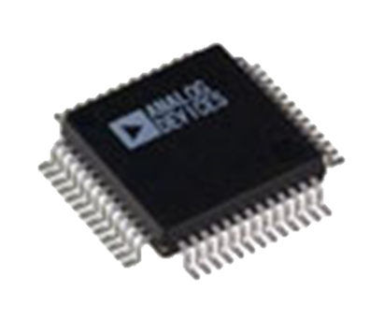
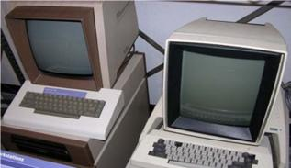
ISTORIJAT RAZVOJA RAČUNARA
Računari 3. generacije (1964-1970)
Osnovne karakteristike:
Integrisana kola;
Drastično povećanje memorije;
Omogućilo je proizvodnju čipova sa hiljadama tranzistora;
Tipični primjeri: IBM 360 (slika), PDP-1.
Notes:
Notes to presenter:
Description of what you learned in your own words on one side.
Include information about the topic
Details about the topic will also be helpful here.
Tell the story of your learning experience. Just like a story there should always be a beginning, middle and an end.
On the other side, you can add a graphic that provides evidence of what you learned.
Feel free to use more than one slide to reflect upon your process. It also helps to add some video of your process.

Slide 19
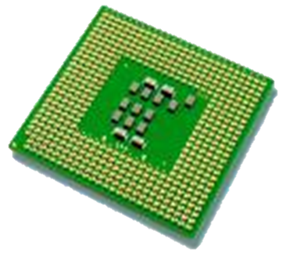
ISTORIJAT RAZVOJA RAČUNARA
Računari 4. generacije (1971-1984)
Osnovne karakteristike:
LSI - Large Scale Integration;
VLSI, Very Large Scale Integration – proces kreiranja integrisanih kola kombinujući hiljade tranzistora u jedan čip;
Razvoj mikroprocesora;
Pojava mini i super računara;
Paralelno procesiranje;
Povećana brzina rada, snaga, memorijski resursi;
Tipični predstavnici: Apple II, IBM PC.
Notes:
Notes to presenter:
Description of what you learned in your own words on one side.
Include information about the topic
Details about the topic will also be helpful here.
Tell the story of your learning experience. Just like a story there should always be a beginning, middle and an end.
On the other side, you can add a graphic that provides evidence of what you learned.
Feel free to use more than one slide to reflect upon your process. It also helps to add some video of your process.

Slide 20
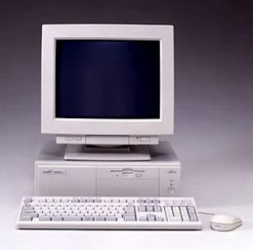
ISTORIJAT RAZVOJA RAČUNARA
Računari 5. generacije (1984-1991)
Osnovne karakteristike:
zasnovana je na konstrukciji paralelne arhitekture koji omogućavaju istovremeni rad više kompjutera (procesora) na rješavanju određenog zadatka;
Paralelna obrada;
Višeprocesorski rad (Multiprocessing);
Konkurentna obrada aplikacija (Multitasking);
Koriste se za prepoznavanje govora i ostalim domenima vještačke inteligencije;
Razvoj super računara.
Notes:
Notes to presenter:
Description of what you learned in your own words on one side.
Include information about the topic
Details about the topic will also be helpful here.
Tell the story of your learning experience. Just like a story there should always be a beginning, middle and an end.
On the other side, you can add a graphic that provides evidence of what you learned.
Feel free to use more than one slide to reflect upon your process. It also helps to add some video of your process.

Slide 21
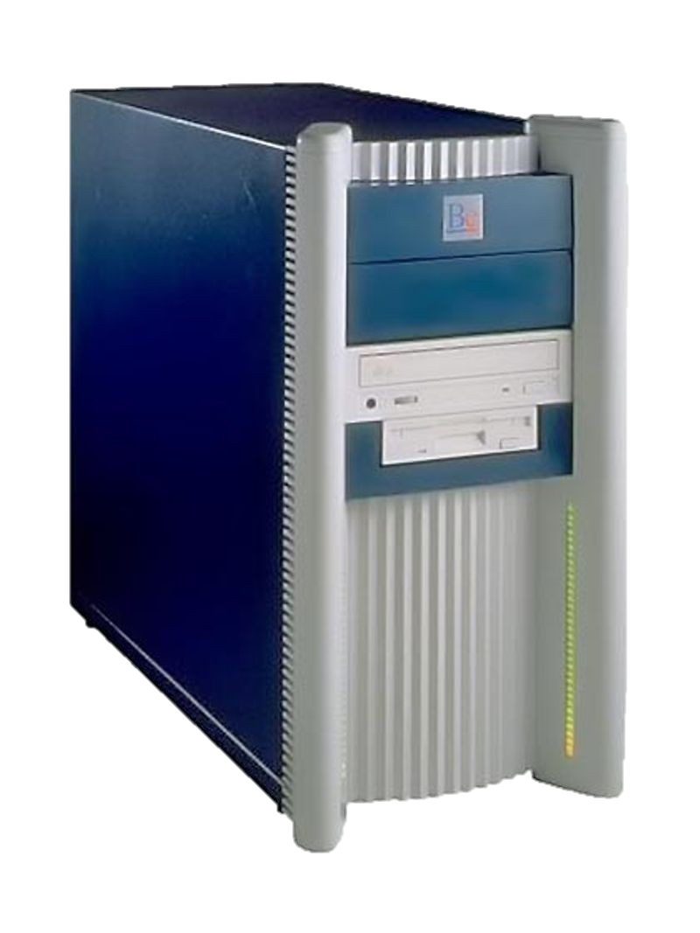
ISTORIJAT RAZVOJA RAČUNARA
Računari 6. generacije (od 1992)
Osnovne karakteristike:
Nano tehnologije i neurokompjuteri.
Tehnologija: paralelno procesiranje/arhitektura.
Brzina: Tflops (Tera Floating point Operations Per Second) (broj operacija sa pokretnim zarezom u sekundi) ≈ 10¹² oper/s.
Procesori: kombinacija RISC arhitekture, protočnosti (pipelining) i paralelnog procesiranja.
Razvoj: WAN i WLAN (bežični LAN).
Notes:
Notes to presenter:
Description of what you learned in your own words on one side.
Include information about the topic
Details about the topic will also be helpful here.
Tell the story of your learning experience. Just like a story there should always be a beginning, middle and an end.
On the other side, you can add a graphic that provides evidence of what you learned.
Feel free to use more than one slide to reflect upon your process. It also helps to add some video of your process.

Slide 22
ISTORIJAT RAZVOJA RAČUNARA
2001: Apple - iPod - digitalni muzički plejer (8, 16 i 32 GB-2007);
2002-2011: razvoj smartphone Nano i iPhone (G1-G6)
2007: iPhone kombinuje 2,5GHz GSM i EDGE celularni telefon
2008: iPhone 3G sa GPS navigacijom
2010: razvoj smart mobilnih telefona (iPad, Apple…)
2011: 6G Nano, 4G iPhone
Notes:
Notes to presenter:
Description of what you learned in your own words on one side.
Include information about the topic
Details about the topic will also be helpful here.
Tell the story of your learning experience. Just like a story there should always be a beginning, middle and an end.
On the other side, you can add a graphic that provides evidence of what you learned.
Feel free to use more than one slide to reflect upon your process. It also helps to add some video of your process.

Slide 23
INFORMATIKA
HVALA NA PAŽNJI

