Slide 1
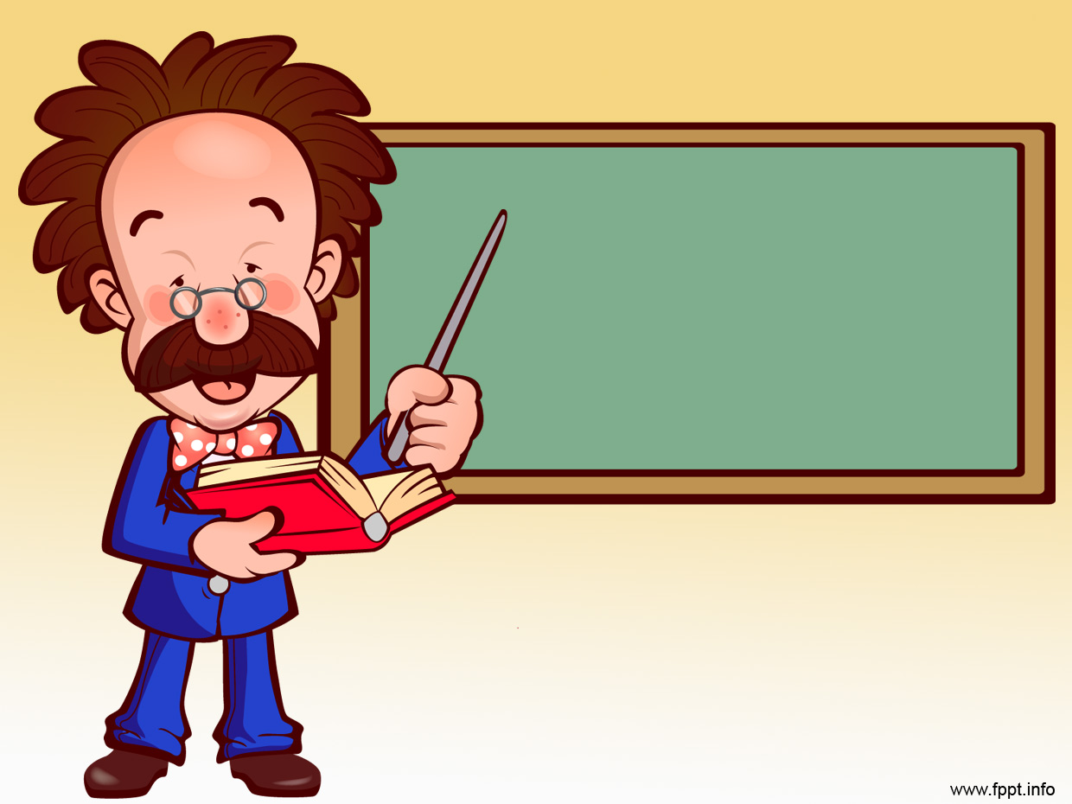
Past Perfect
credits: www.islcollective.com

Slide 2
I. Fill in the gaps with the Past Perfect of the verbs given
When I got to the station, the train
……………….. [already / leave].
had already left

Slide 3
I. Fill in the gaps with the Past Perfect of the verbs given
2. Before I lost my wallet I
………….. [lose] my umbrella.
had lost

Slide 4
I. Fill in the gaps with the Past Perfect of the verbs given
3. By the time the doctor arrived, the patient ………………..[die].
had died

Slide 5
I. Fill in the gaps with the Past Perfect of the verbs given
4. When Anna phoned, I ………[leave] to work.
had left

Slide 6
I. Fill in the gaps with the Past Perfect of the verbs given
5. Before Sarah crossed the road, she……………. [look] both ways.
had looked

Slide 7
I. Fill in the gaps with the Past Perfect of the verbs given
6. Before I had a driving license, I………….. [have] a driving test.
had had

Slide 8
I. Fill in the gaps with the Past Perfect of the verbs given
7. Before he……………. [fill] in the application form, he looked for job offers in the newspaper.
had filled

Slide 9
I. Fill in the gaps with the Past Perfect of the verbs given
8. When I looked up, the burglar ……………. [go].
had gone

Slide 10
I. Fill in the gaps with the Past Perfect of the verbs given
9. When the police arrived, the riots…………. [stop].
had stopped

Slide 11
I. Fill in the gaps with the Past Perfect of the verbs given
10. After we……………. [reach] an agreement, we shook hands.
had reached

Slide 12
II. Look at the sentences and decide which happened first
1. By the time Charles arrived at the office, the boss had already left for the meeting.
Charles arrived at the office.
The boss left for the meeting.

Slide 13
II. Look at the sentences and decide which happened first
2. Britney had washed all the dishes when her husband came.
Britney washed all the dishes.
Her husband came.

Slide 14
II. Look at the sentences and decide which happened first
3. After he had had the accident, he reported it to the insurance company.
He reported it to the insurance company.
He had an accident.

Slide 15
II. Look at the sentences and decide which happened first
4. Tom had saved a lot of money so he bought a motorbike.
Tom saved a lot of money.
He bought a motorbike.

Slide 16
II. Look at the sentences and decide which happened first
5. After Margaret had read the book, she took it back to the library.
She took the book back to the library.
Margaret read the book.

Slide 17
II. Look at the sentences and decide which happened first
6. Before my parents visited London, they had visited Paris.
My parents visited London.
My parents visited Paris.

Slide 18
II. Look at the sentences and decide which happened first
8. I read the book after I’d seen
the film.
I saw the film and then I read the book.
I read the book and then I saw the film.

Slide 19
II. Look at the sentences and decide which happened first
7. We’d had dinner when Ann arrived.
We had dinner and then Ann arrived.
Ann arrived and then we had dinner.

Slide 20
III. Fill in the gaps using past simple and past perfect
1.We ___________ (just, hear)the news when you ________(ring).
2.I ___________(already think)of that before you ________ (suggest)it.
3.When I _______(turn on) the TV the programme ___________(already start).
4.She ______ (to be) hungry because she ________ (not eat) anything all day.
5. By the time I _______ (leave) school I _________ (decide) to become a musician.

Slide 21
Strange Days in a strange country.
Anna was crying and her mum looked angry. What had happened?

Slide 22
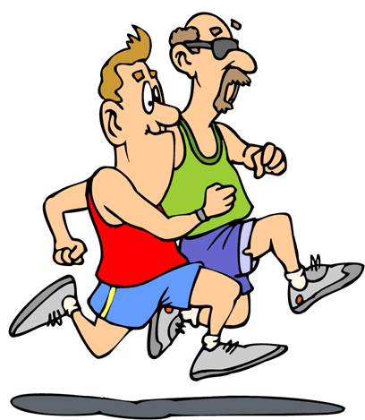
Strange Days in a strange country.
Masha was running down Sumskoy pr. at midnight. What had happened?

Slide 23
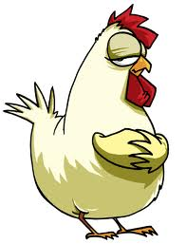
Strange Days in a strange country.
Stas was wearing a big coat and had a chicken in his pocket. What had just happened?

Slide 24
Strange Days in a strange country.
Sasha was crying with laughter. What had just happened?

Slide 25
Strange Days in a strange country.
Alex went to his room, but it was a different colour. What had happened?

Slide 26
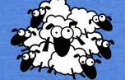
Strange Days in a strange country.
Kate’s bedroom was full of sheep. What had happened?

Slide 27
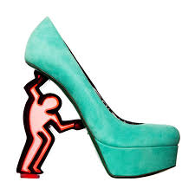
Strange Days in a strange country.
Vika was wearing one shoe and holding a dead rat. What had happened?

