Slide 1
Grade: 2 SHOPS AND SHOPPING -VOCABULARY-

Slide 2
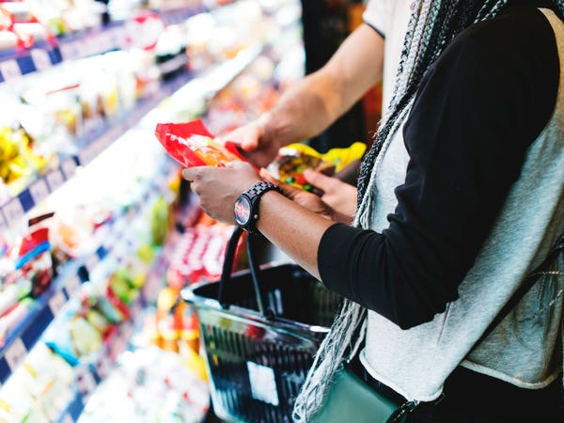
Exercise 1
CHOOSE THE RIGHT OPTION
1- THIS NEW SHOP HAS A LOT OF GOOD BARGAINS/SALES.
2- YOU CAN’T RETURN GOODS WITHOUT THE RECIPE/RECEIPT.
3-IF YOU PAY CASH YOU WILL BE GIVEN A 10% CUTTING/DISCOUNT.
4-HOW MUCH DID YOU PAY/ SPEND FOR THE COAT?
5-THIS IS THE BEST SHOE SHOP, BUT THE COSTS/ PRICES ARE VERY HIGH.

Slide 3
Exercise 2
COMPLETE EACH SENTENCE (A-E) WITH A SUITABLE ENDING (1-5)
A- DON’T FORGET TO WRITE A SHOPPING..................
B-SALLY STARTED WORKING AS A SHOP...................
C-I BOUGHT MY CD PLAYER FROM A DEPARTMENT.................
D-CAN YOU PAY OVER THERE? THIS CASH...............
E- LET’S GO TO THE NEW SHOPPING...............
1- STORE NEAR MY HOUSE.
2- LIST BEFORE GOING TO THE SUPERMARKET
3- REGISTER DOESN’T WORK.
4. CENTRE NEAR THE POST OFFICE
5- ASSISTANT IN A BOOKSHOP

Slide 4
Exercise 3
DECIDE WHICH ANSWER (A B OR C) BEST FITS EACH PLACE
WHEN I 1).............. SHOPPING, I ENJOY VISITING STREET 2).............. AND LOOKING FOR 3)..............I ASK ABOUT 4)............. MANY GOODS ON SALE ARE NOT AS 5)............. AS IN SHOPS THOUGH THE 6) ............. IS NOT ALWAYS GOOD. CLOTHES ARE OFTEN 7).............. BUT YOU CAN’T 8) ............. THEM ON. SO, YOU SHOULD THINK CAREFULLY WHEN BUYING AT THOSE PLACES.
1- A. MAKE B.GO C. DO
2- A. MARKETS B.SHOPS C. SALES
3- A. VALUES B.SPECIALS C. BARGAINS
4. A.PRICES B. PRIZES C. VALUES
5. A. MORE EXPENSIVE B. EXPENSIVE C- CHEAPER
6- A. QUALITY B- KIND C. TYPE
7- A. CHEAPER B. CHEAP C. THE CHEAPEST
8- A. PUT B. WEAR C. TRY

Slide 5
Exercise 4
WRITE THE DIALOGUE IN ORDER
YOU: YES, I’M LOOKING FOR A T-SHIRT
YOU: I’M SMALL
A: CAN I HELP YOU?
YOU: YES, THAT’S NICE, CAN I TRY IT ON?
A: WHAT SIZE ARE YOU?
YOU: PERFECT,I’LL TAKE IT. HOW MUCH IS IT?
A: CERTAINLY,MADAM. HOW DOES IT FIT?
A: IT’S $ 20. HOW WOULD YOU LIKE TO PAY?
YOU: HERE IS MY CREDIT CARD
YOU: THANKS. GOODBYE
A: THANK YOU. HAVE A NICE DAY
YOU: DO YOU TAKE CREDIT CARDS?
A: YES WE DO
A: HOW ABOUT THIS ONE?

