Slide 1
1
2
3
4

Slide 2
is used to talk about an action which happened before another action in
the
past

Slide 3
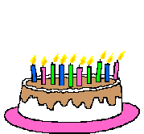
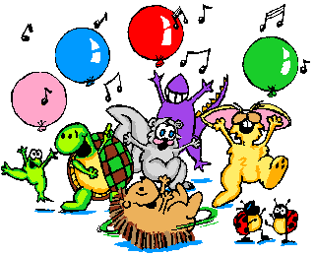
Mum had baked
a cake
before the party started.
Mum baked a cake.
The party started.
now

Slide 4
is used to talk about an action which happened before a stated time in
the
past

Slide 5
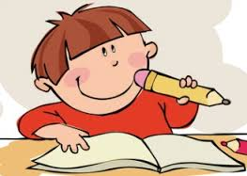
Lenny had done his homework
by seven o’clock.
Lenny had done his homework .
5 o’clock
7 o’clock
now

Slide 6
had + past participle
regular
irregular
verb + ed
3rd column

Slide 8
1
2
3
4

Slide 9
Decide which action in the past took place 1st and which took place 2nd.
I felt better.
2nd
when
I took an aspirin.
1st
When I had taken an aspirin, I felt better.

Slide 10
Decide which action in the past took place 1st and which took place 2nd.
1st
We called a taxi.
before
We locked the door.
2nd
Before we locked the door, we had called a taxi.

Slide 11
Decide which action in the past took place 1st and which took place 2nd.
1st
It stopped raining.
as soon
as
We took our dog
for a walk.
2nd
As soon as it had stopped raining, we took our dog for a walk.

Slide 12
Decide which action in the past took place 1st and which took place 2nd.
We reached the railway station.
by the
time
2nd
1st
The train left.
By the time we reached the railway station, the train had
left.

Slide 13
Decide which action in the past took place 1st and which took place 2nd.
He spoke to a policeman.
2nd
after
He saw an accident.
1st
After he had seen an accident, he spoke to a policeman.

