Slide 1
CONDITIONAL SENTENCES
TYPE 3

Slide 2
CONDITIONAL SENTENCES TYPE III refer to situations in the past. An action could have happened in the past if a certain condition had been fulfilled. Things were different then, however. We just imagine, what would have happened if the situation had been fulfilled.
Example: If I had found her address, I would have sent her an invitation.
Sometime in the past, I wanted to send an invitation to a friend. I didn't find her address, however. So in the end I didn't send her an invitation.

Slide 3
We form those sentences:

Slide 4
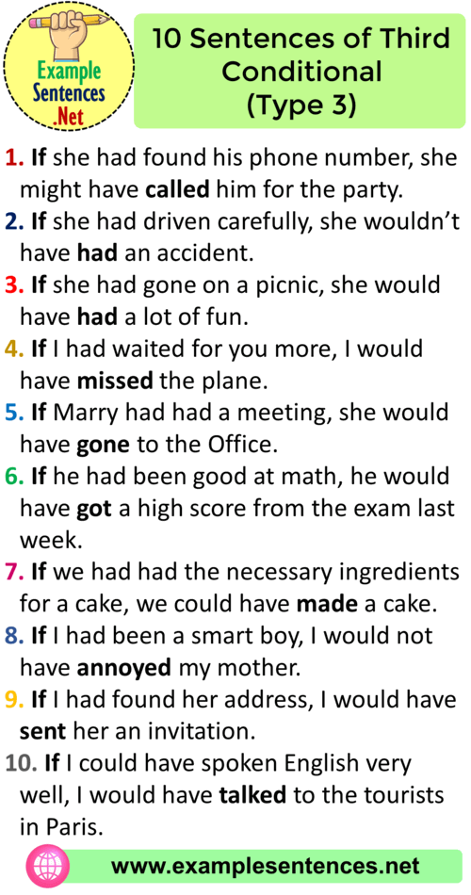
EXAMPLES:

Slide 5
EXERCISES: Complete the conditional sentences (type III) by putting the verbs into the correct form:
If you_____ (study) for the test, you______ (pass) it.
If you______ (ask) me, I______ (help) you.
If we_______ (go) to the cinema, ______we (see) my friend Jacob.
If you_______ (speak) English,________ she (understand) .
If they ________(listen) to me, we________ (be) home earlier.
I________ (write) you a postcard if I ________(have) your address.
If _________I (not / break) my leg, I ________(take part) in the contest.
If it_______ (not/ start) to rain, we _______(walk) to the museum.
We_______ (swim) in the sea if there _______(not / be) so many sharks there.
If she _______(take) the bus, she _________(not / arrive) on time.

Slide 6
For your homework do the quiz: https://eflnet.com/grammar/conditionals.php
If you are not still confident about using conditional sentences, watch the video…..
https://www.youtube.com/watch?v=GHc3runur3M

