Slide 1
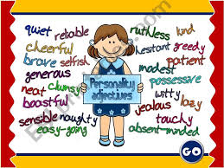
Ana Marković
Ana Delić

Slide 2
OPPOSITES
Pametan ‡ glup
Zabavan ‡ ozbiljan

Slide 3
OPPOSITES
Dosadan ‡ zanimljiv
Ljubazan ‡ neljubazan

Slide 4
Adjective antonyms
Caring -brizan
Cheerful- razdragan
Hard working-vrijedan
Modest -skroman
Outgoing -druzeljubiv
Sensible -razuman
Selfish-sebican
Miserable-očajan
Lazy- lijen
Arrogant-arogantan
Shy- stidljiv
Crazy -luckast

Slide 5
Negative prefixes
Experienced-iskusan
Fair -pravedan
Honest-posten
Popular-popularan
Responsible-odgovoran
INexperienced-neiskusan
Unfair- nepravedan
DIShonest-neposten
UNpopular-nepopularan
IRresponsible-neogovoran

Slide 6
Homework-Exercises:
I Write the opposites of these adjectives.(Napisi pridjeve suprotnog znacenja)
shy ≠
popular ≠
caring ≠
experienced ≠
responsible ≠
modest ≠
fair ≠
crazy ≠
honest ≠
cheerful ≠

Slide 7
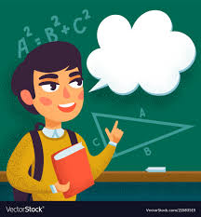
II Classify adjectives into two groups.(Klasifikuj pridjeve u 2 grupe: pridjevi sa pozitivnim i negativnim znacenjem)
Honest outgoing
Fair kind
Unpopular interesting
Responsible caring
Miserable
Stupid hard-working
Personality
Adjectives

Slide 8
III Describe your brother/sister/friend with 2-3 adjectives from the previous slides.(Opisi brata/sestru/druga sa 2-3 pridjeva sa prethodnih slajdova)
My brother is/isn’t ____________________
My sister is/isn’t ______________________
My friend is/isn’t ______________________
Positive
Negative

