Slide 1
A DESCRIPTION OF A PERSON Essay

Slide 2
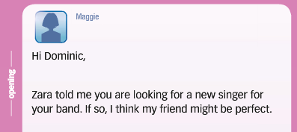
When you want to describe a person in an email you need to have:
- An opening like in an example below (primjer uvoda)

Slide 3
Body – when writing a body, you have to:
1. Mention age (navedite godine)
-He/she is about my/your/our age
-He/she is in his/her teens, early/mid/late twenties
2. Describe personality and interests (opišite ličnost i interese)
-He’s a very easy-going, interesting person
-She’s the sort /type/ kind of person who always remembers your birthday/ loves kids
-She’d make a great teacher/doctor/friend
-He’s into music /fashion /skateboarding.
-He has a great sense of humor
-She’s caring / charming / outgoing/ reliable
-She is childish/ cheeky/ arrogant/ rude

Slide 4
3. Describe hair, eyes, skin and face (opišite kosu, oči, kožu i lice)
-He’s got cool, short, dark hair.
-She’s got beautiful, long, straight, blond hair.
-She’s got a kind/ friendly /unusual smile/ face.
-He’s dark-skinned / pale-skinned.
-He’s blue-eyed
4. Mention height/ build (navedite visinu/građu)
-She’s short/ medium height / tall
-He’s fairly well built/ slim

Slide 5
5. Give general impressions. (Navedite opšti utisak )
-She looks (kind of) cool/ unusual/ mysterious/ unhappy/ nervous
-He looks a bit like you/ me/ Mr Bean / Ronaldo
-He resembles his father
6. Mention clothes (opišite odjeću)
-She dresses casually / smartly / well / in black
-He always wears casual / smart (elegantan) / scruffy (prljav) / fashionable / stylish clothes
-He never wears a tie

Slide 6
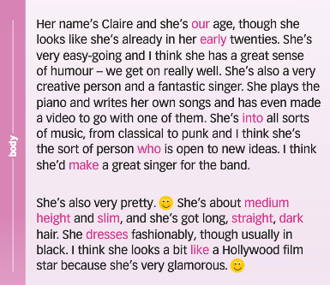
Example of the body of email (primjer razrade)

Slide 7
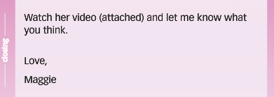
An example of a closing of an email (primjer zaključka)

