Slide 1
Writing
Review of an event

Slide 2
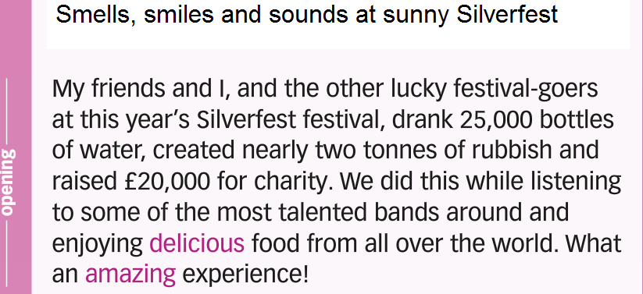

Slide 3
