Slide 1
ENGLISH CLASS
With Teacher Ana

Slide 2
Past Perfect Simple and Continuous

Slide 3
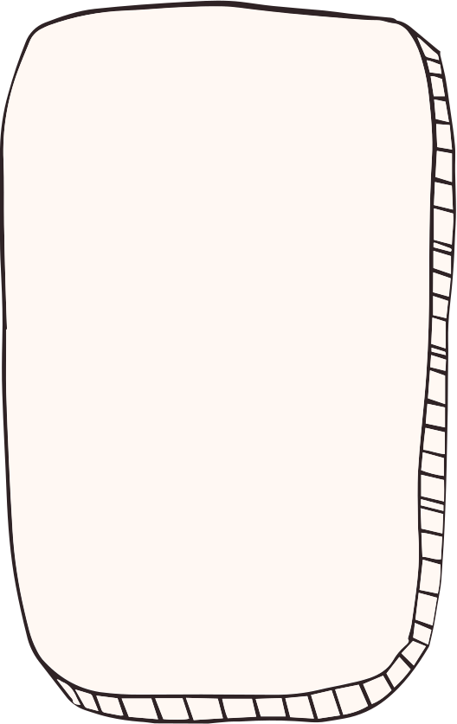

Slide 7
Remember!

Slide 9
ACTIVITY TIME

Slide 13
Complete the text with words from the box

Slide 14
Homework
workbook p 24

