Slide 1
English Grammar Lesson
Verb + ‘ING’
VERB
PATTERNS
Verb + ‘TO INF’
Ana Markovic
Ana Delic

Slide 2
Verb patterns
When a verb follows another verb , the structure we use is
Verb + ‘ing’
Verb+ ‘to’ infinitive
Verb + ‘ing’ or ‘to’ infinitive
Verb + somebody + ‘to’ infinitive

Slide 3
Verbs + ‘ing’
*We can sometimes use with ‘to’ but ‘ing’ is more usual.
I like to go…
I like going…
Like*
Love*
Adore
enjoy
Prefer*
Hate *
Finish Examples:
Don’t mind 1. I love fishing.
Can’t stand 2. I adore spending time with my family.
look forward 3. I look forward to meeting you again.
Miss
Avoid
Spend time

Slide 4
Verb + ‘to’+infinitive
Agree -choose
Decide -expect
Forget - help
Learn - manage
Need
Offer
Promise
Refuse
Seem
Want
Would like
Would prefer
Can’t afford
consider
Examples:
I choose to wear a suit to work.
He expects to come on time.
She seems to be a little nervous.
Don’t forget to pick me up at 8 o’clock.
I would love to visit London this summer.

Slide 5
Verbs +’ing’ or ‘to’ infinitive (no change in meaning)
Begin
Start
Continue
Examples:
It began to rain. = It began raining.

Slide 6
Verbs +’ing’ or ‘to’ infinitive(with a change in meaning)
REMEMBER
1. I remember buying a chocolate.
(I have a memory)
2. I remembered to buy a chocolate.
(I reminded myself)
STOP
1. I stopped eating chocolate.(I don’t eat it anymore)
2. I stopped to eat some chocolate.
(I stopped doing something)
TRY
1. I tried to call his office,but the line was busy.
(I made the effort)
2. So I tried calling his mobile.
(Experiment with a new method.)

Slide 7
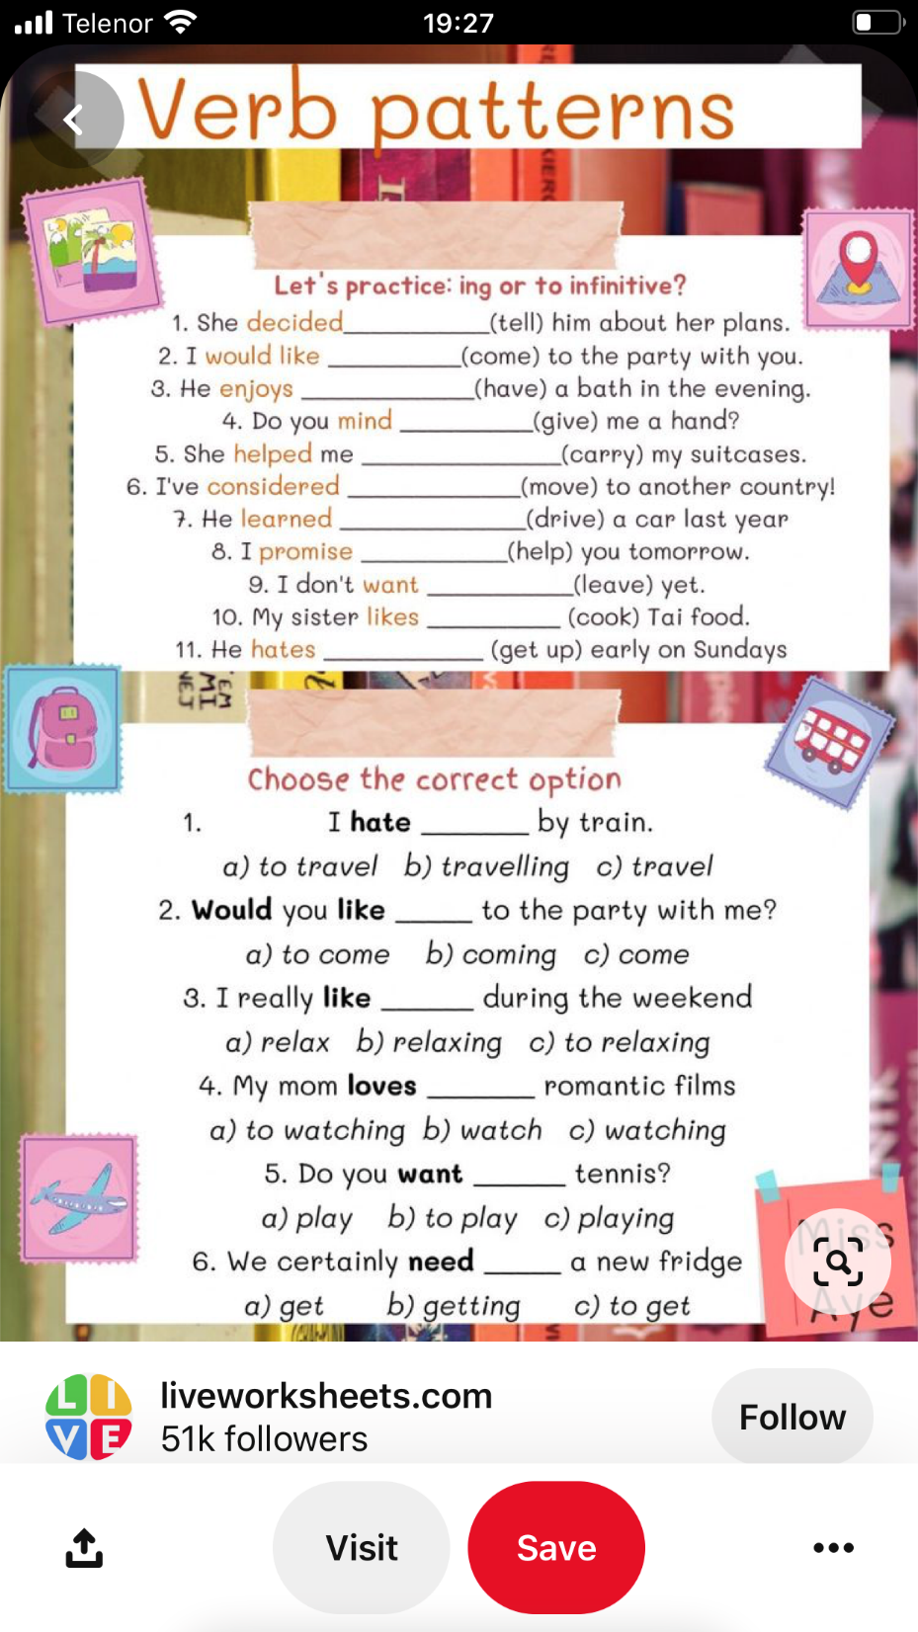
HOMEWORK

