Slide 1
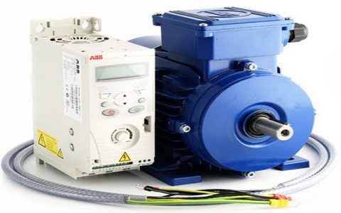
ELECTRIC DRIVE
Teacher:
Ana Markovic

Slide 2
What is an Electric Drive?
An Electric Drive - a system which is used to control the movement of an electrical machine.
a kind of electrical device used to control the energy which is sent to the electrical motor. The drive supplies energy to the motor in unstable amounts & at unstable frequencies, thus ultimately controls the speed and torque of the motor
This drive employs a prime mover such as a petrol engine, otherwise diesel, steam turbines otherwise gas, electrical & hydraulic motors like a main source of energy.

Slide 3
Types
standard inverter (to control the torque & speed)
servo drive( control the torque as well as speed, and also components of the positioning machine utilized within applications that need difficult motion)

Slide 4
Block Diagram of Electric Drive

Slide 5
Power Source
The power source - offers the necessary energy for the system.
Power Modulator
This modulator can be used to control the o/p power of the supply. The power controlling of the motor can be done in such a way that the electrical motor sends out the speed-torque feature which is necessary with the load.

Slide 6
Load
The mechanical load can be decided by the environment of the industrial process & the power source can be decided by an available source at the place. However, we can choose the other electric components namely electric motor, controller, & converter.
Control Unit
The control unit is mainly used to control the power modulator, and this modulator can operate at power levels as well as small voltage. And it also works the power modulator as preferred. This unit produces the rules for the safety of the motor as well as power modulator. The i/p control signal regulates the drive’s working point from i/p toward the control unit.

Slide 7
Sensing Unit
The sensing unit in the block diagram is used to sense the particular drive factor such as speed, motor current. This unit is mainly used for the operation of closed loop otherwise protection.
Motor
The electric motor intended for the specific application can be chosen by believing various features such as price, reaching the level of power & performance necessary by the load throughout the stable state as well as active operations.

Slide 8
Classification of Electrical Drives
Three types:
group drive,
individual drive, and
multi-motor drive
Two types based on supply
AC drives
DC drives.
Two types based on running speed
Constant speed drives
changeable speed drives.
Two types based on a number of motors
Single motor drives
multi-motor drives.
Two types based on control parameter
stable torque drives
stable power drives.

Slide 9
Advantages of Electrical Drives
These dries are obtainable with an extensive range of speed, power & torque.
Not like other main movers, the requirement of refuel otherwise heat up the motor is not necessary.
They do not contaminate the atmosphere.
They have flexible manage characteristics due to the utilization of electric braking.
At present, the AC motor is used within variable speed drives because of semiconductor converters development.

Slide 10
Disadvantages of Electrical Drive
This drive cannot be used where the power supply is not accessible.
The power breakdown totally stops the entire system.
The primary price of the system is expensive.
The dynamic response of this drive is poor.
The drive output power which is obtained is low.
By using this drive noise pollution can occur.

Slide 11
Applications of Electrical Drives
Electric traction which means transportation of materials from one location to another location. The different types of electric tractions - electric trains, buses, trolleys, trams, and solar-powered vehicles inbuilt with battery.
Huge number of domestic as well as industrial applications which includes motors, transportation systems, factories, textile mills, pumps, fans, robots, etc.
Main movers for petrol or diesel engines, turbines like gas otherwise steam, motors like hydraulic & electric.

