Slide 1
ENGLISH CLASS
With Teacher Ana Marković

Slide 2
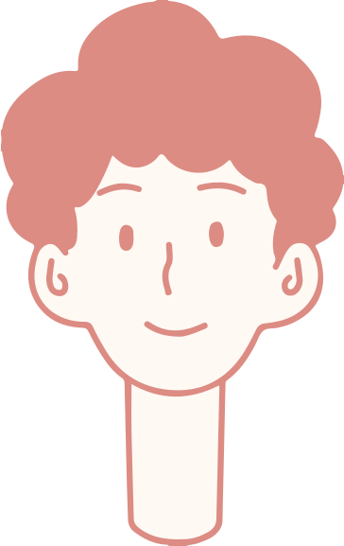
Welcome, students!

Slide 3
LESSON FOR THE DAY
REVISION

Slide 4
MATCH VERBS TO COMPLETE THE SENTENCES

Slide 5
Complete the text with one word

Slide 6
Complete the sentences with correct form of the verbs in brackets

Slide 7
Complete the second sentence so that it has a similar meaning to the first, using the word in capitals.

Slide 8
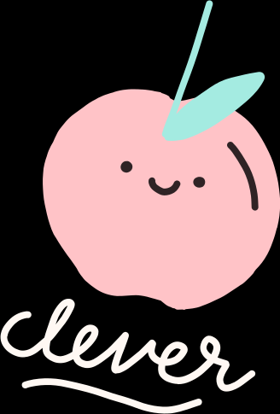
Writing task

Slide 9
Thank You for Attention

