Slide 1
Future forms
Explanation and examples
English teachers (IV)grade

Slide 2
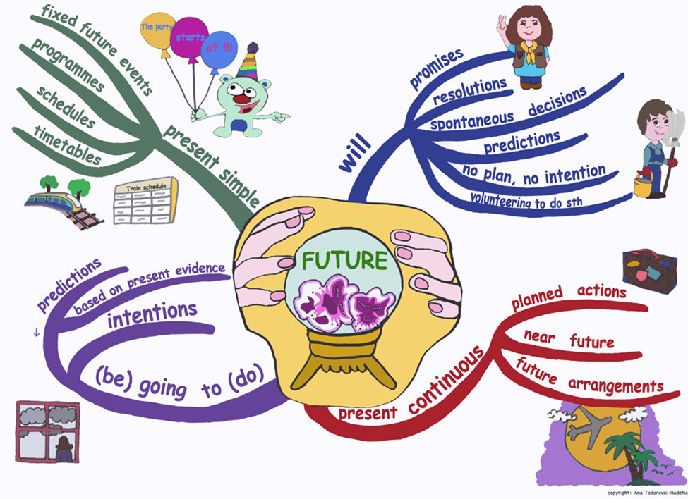
To express different future activities we use:

Slide 3
Will/won’t + infinitive
* predictions based on opinion (weak evidence) *
-It will probably rain tomorrow.
-I think we will use flying cars in 2050.
* sudden or spontaneous decisions *
The bell is ringing. I’ll open the door.
Oh! I like those shoes… I’ll buy them.
* promise *
Tell me the secret! Don’t worry! I won’t tell anyone!
* offers *
- I am going to the supermarket. Shall I buy some milk?

Slide 4
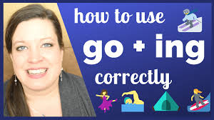
Be (am, is, are) + going to + inf.
* predictions based on the fact (strong evidence) *
Look at those black clouds! It’s going to rain!
The floor is wet! You’re going to fall! Be careful!
* plan or intention *
- I am going to visit my grandparents at the weekend.
- They are going to watch football match on Sunday.

Slide 5
Am, is are + V-ing
*Arranged future activities *
- I am flying to London on Friday.
( I’ve bought the tickets)
- He is meeting his friends tonight.
(they have already arranged to see each other)
- She is seeing her dentist tomorrow at 10 o’clock.
(she’s already made an appointment)

Slide 6
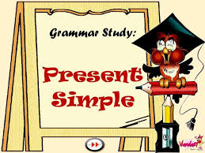
V/V-s
* Scheduled future event *
- We have a lesson next Monday.
- The train arrives at 6.30 in the morning.
-The holidays start next week.
- It’s my birthday tomorrow.
* The activities are usually scheduled by someone else and they are usually public events.

Slide 7
!All in one place

Slide 8
BUT- there is more…. What’ s this now?
Future Continuous tense
Future Perfect tense
Future Perfect Continuous tense

Slide 9
Future Continuous will be + V-ing
* actions will be ongoing at some time in the future *
(tomorrow morning, in one year, next Monday)
- What will you be doing tomorrow at 8 pm?
- I will be watching a film.
- He will be attending a webinar next Monday.
- They will be playing football at 10 am tomorrow.
- He will be enjoying the holidays in December.
Note:
This action always takes places in specific time interval

Slide 10
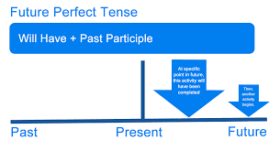
Future Perfect will have + Past Participle (V-ed/3rd)
* An event that is expected or planned to happen before a time of reference in the future (will be completed before some other point in the future-by, before, when etc.)
- You will have finished your report by this time next week.
- Will you have eaten when I pick you up?
- We will have recovered from Coronavirus by the end of May.

Slide 11
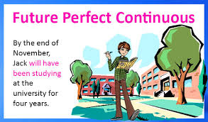
Future Perfect Continuous will/won’t have been + V-ing
*events or actions that are currently unfinished but will be finished at some particular future time *
-I will have been waiting here for three hours by six o’clock.
- By 2021, I will have been living in London for 16 years.
- When I finish this course, I will have been learning English for twenty years.

Slide 12
Exercises:
Put verbs in brackets in correct future tense (future continuous or future perfect):
1. 1. This time tomorrow, Maria _________ on a beach in Majorca. (sunbathe)
2. Wake me up by nine o'clock - I ____________ long enough by then. (sleep)
3. Look, I can give you a lift to the station - I _______________ that way anyway. (drive)
4. It's strange that when we get to Sydney, we______________ half way round the world. (fly)
5. Don't phone me between 7 and 8. We_____________ dinner then. (have)
6. Phone me after 8 o'clock. We dinner by then._____________ (finish)
7. Tomorrow afternoon we're going to play tennis from 3 o'clock until 4.30. So at 4 o'clock, we_______ tennis. (play)
8. Do you think you____________ the same job in ten years' time? (still/do)
9. By the time you get home I_____________ the house from top to bottom. (clean)
10. Tom is on holiday and he is spending his money very quickly. If he continues like this, he_______ all his money (spend

