Slide 1
Vocabulary
0.1 Homes, 0.2 food, 0.3 shops

Slide 2
Vocabulary
Bungalow – a house that usually has one storey (level)
Cottage – a small house, usually in the countryside
Semi-detached house – a house that is joined to another similar house on one side
Detached house - a house that is not joined to any other house
Terraced house - is one of a row of similar houses joined together by their side walls

Slide 3
Put the words for houses and rooms in the right category

Slide 4
Complete the words in the sentences. The first letter of each word is written

Slide 5
Write a type of food or drink for each letter of the alphabet
For example:
A- apple
B- banana
C- carrot
D…

Slide 6
Complete the shopping list. Use the words from the box below

Slide 7
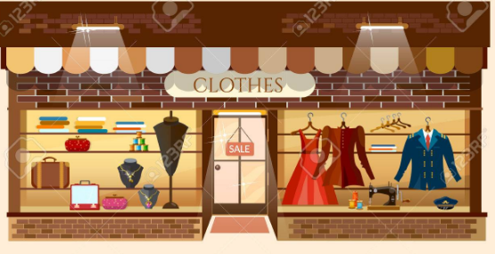
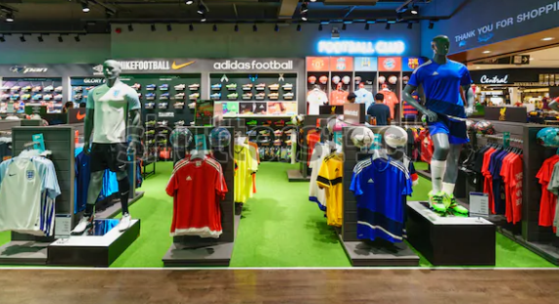
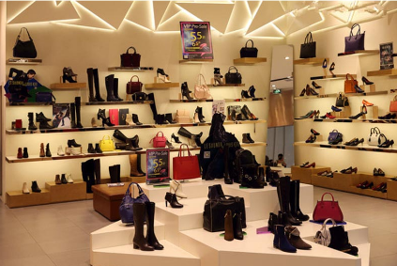
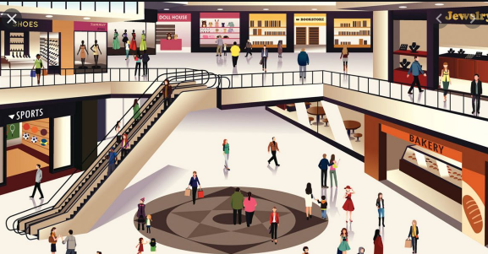
Shops
clothes shop
sports shop
department store
shoe shop

Slide 8
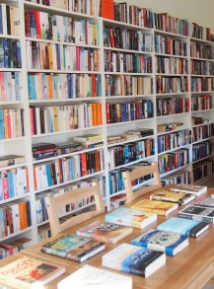
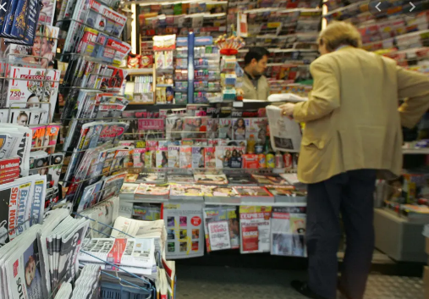
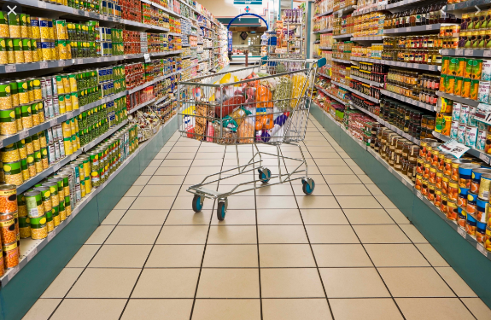
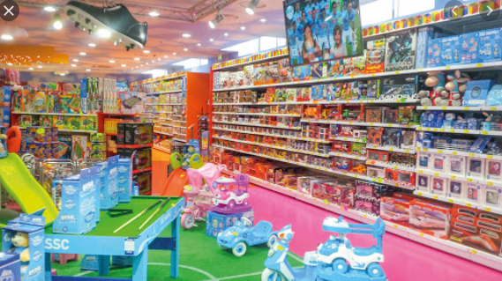
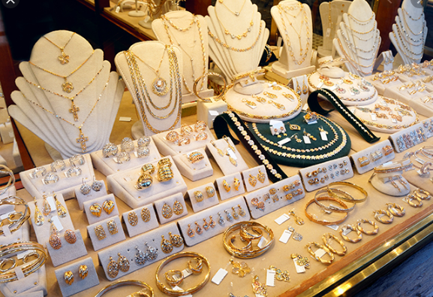
newsagents
supermarket
bookshop
toyshop
jeweller’s

