Slide 1
ENGLISH CLASS
With Teacher Elida

Slide 2
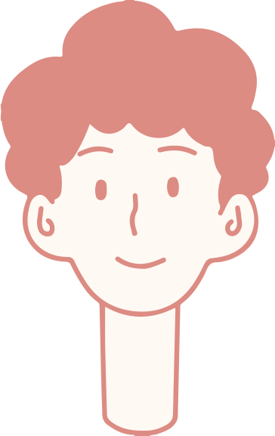
Welcome, students!
Focus 4Unit 1.2 Present and Past Habits

Slide 3
CLASS OBJECTIVE:
TO TALK ABOUT PRESENT AND PAST HABITS
Present habits
Present Simple
Present Continuous
Will + Infinitive
Past Habits
Past Simple
Past Continuous
Would + Infinitive
Used to

Slide 4
Present Simple
Present habits
Repeated present actions or states
When I get home, I do my homework and then practice the violin.

Slide 5
PRESENT CONTINUOUS
present habits and repeated actions that annoy us:
She's always putting things off and is never in time.
My neighbors were constantly complaining about the noise.
(adverbs: always, forever, constantly, continually)

Slide 6
will + infinitive
to talk about present actions or typical behavior
She'll watch TV or play games all day instead of studying for her exams.
She will get up and move around instead of listening to the teacher.
NOTE: DO NOT use in questions or with state verbs

Slide 7
Past Simple
Past habits
Repeated Past actions
States
My grandfather picked me up from school every day.

Slide 8
Past Continuous
past habits and repeated actions that annoyed us
My neighbors were always complaining about the noise.
She was always fidgeting and handing in her homework late.
Adverbs: always, continually, constantly, forever.

Slide 9
Would +infinitive
to talk about past actions or behavior typical for someone (BUT NOT STATES and IN QUESTIONS)
Martha would ask the teacher plenty of questions after every lesson. She vas very curious.
Her teachers would complain about her disruptive behavior.

Slide 10
USED TO+ INFINITIVE
to talk about states (e.g. with the verbs be, have, believe, like) or actions that happened regularly in the past but are no longer happening in the present.
When I was your age, I used to be very eager to learn.
When I was kid , I used to believe that my dad was a spy.
NOTE: we do not use this structure to talk about single past actions

Slide 11
write sentences comparing your routine in primary school and now.
For breakfast I'd have cereal with milk in primary school, but now I'll just have a piece of toast.
(e.g. after school, before going to bed, at break time, at lunchtime...)

Slide 12
THANK YOU! :)

