Slide 1
Basic elements of energetic systems
Ana Marković

Slide 2
Power plants
A power station, also referred to as a power plant is an industrial facility for the generation of electric power. Power stations are generally connected to an electrical grid.
Many power stations contain one or more generators, a rotating machine that converts mechanical power into three-phase electric power.
The energy source harnessed to turn the generator varies widely. Most power stations in the world burn fossil fuels such as coal, oil, and natural gas to generate electricity. Clean energy sources include nuclear power, and an increasing use of renewables such as solar, wind, wave, geothermal, and hydroelectric.

Slide 3
Turbines
A turbine is a device that harnesses the kinetic energy of some fluid - such as water, steam, air, or combustion gases - and turns this into the rotational motion of the device itself.
A simple turbine is composed of a series of blades - currently steel is one of the most common materials used - and allows the fluid to enter the turbine, pushing the blades. These blades then spin and eject the fluid which now has less energy it did than when it entered the turbine.
Turbines are used in wind power, hydropower, in heat engines, and for propulsion. Turbines are extremely important because of the fact that nearly all electricity is generated by them.
Types: steam turbines, combustion gas turbines, hydro electric turbines, wind turbines.

Slide 4
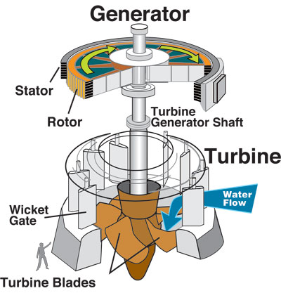

Slide 5
Generators
An electric generator is a device that converts a form of energy into electricity. There are many different types of electricity generators.
Electromagnetic generators use an electromagnet—a magnet produced by electricity—not a traditional magnet. A basic electromagnetic generator has a series of insulated coils of wire that form a stationary cylinder—called a stator—surrounding an electromagnetic shaft—called a rotor.
Turning the rotor makes an electric current flow in each section of the wire coil, which becomes a separate electric conductor. The currents in the individual sections combine to form one large current. This current is the electricity that moves from generators through power lines to consumers.

Slide 6
Turbine driven generators
Most of world electricity generation is from electric power plants that use a turbine to drive electricity generators. In a turbine generator, a moving fluid—water, steam, combustion gases, or air—pushes a series of blades mounted on a rotor shaft. The force of the fluid on the blades spins/rotates the rotor shaft of a generator. The generator, in turn, converts the mechanical (kinetic) energy of the rotor to electrical energy.

Slide 7
Transmission lines
Transmission lines carry electric energy from one point to another in an electric power system. They can carry alternating current or direct current or a system can be a combination of both.
Also, electric current can be carried by either overhead or underground lines. The main characteristics that distinguish transmission lines from distribution lines are that they are operated at relatively high voltages, they transmit large quantities of power and they transmit the power over large distances. The types of transmission lines are:
Overhead Transmission Lines
Subtransmission Lines
Underground Transmission Lines

Slide 8
Overhead AC transmission lines share one characteristic; they carry 3-phase current. Transmission voltages vary from 69 kV up to 765 kV. The DC voltage transmission tower has lines in pairs rather than in threes (for 3-phase current) as in AC voltage lines. One line is the positive current line and the other is the negative current line.
Subtransmission lines carry voltages reduced from the major transmission line system. Typically, 34.5 kV to 69 kV, this power is sent to regional distribution substations.
Underground transmission lines are more common in populated areas. They may be buried with no protection, or placed in conduit, trenches, or tunnels.

Slide 9
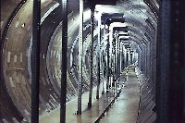
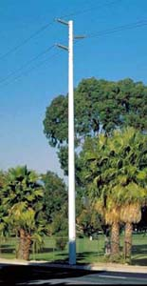

Slide 10
Transformers
A transformer is defined as a passive electrical device that transfers electrical energy from one circuit to another through the process of electromagnetic induction.
It is most commonly used to increase (‘step up’) or decrease (‘step down’) voltage levels between circuits.
The three main parts of a transformer:
1. Primary Winding of Transformer
2. Magnetic Core of Transformer
3. Secondary Winding of Transformer

