Slide 1
ENGLISH LESSON
Focus 4 unit 3.1 A place to live
Teacher Elida

Slide 2
WHEN IN ROME, DO AS THE ROMANS DO.

Slide 3
HOW FAR YOU NEED TO GO TO SEE AN EXAMPLE OF EACH FEATURE BELLOW? WHICH IS THE NEAREST? WHICH IS THE FURTHEST?

Slide 4
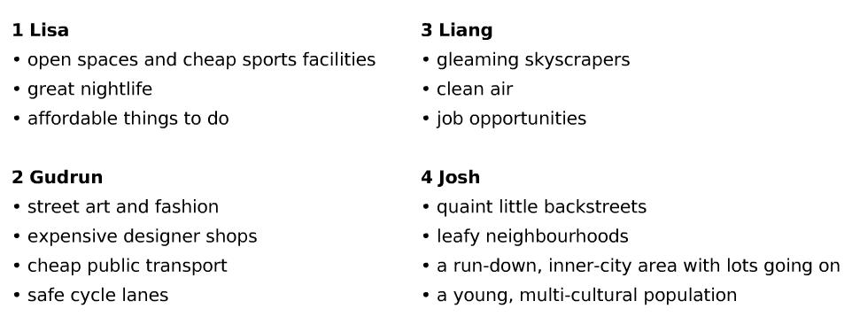
LISTEN TO FOUR TENAGERS TALKING ABOUT WHAT MAKES A CITy A GOOD PLACE FOR YOUNG PEOPLE. WHICH THINGS ARE IMPORTANT TO THEM

Slide 5
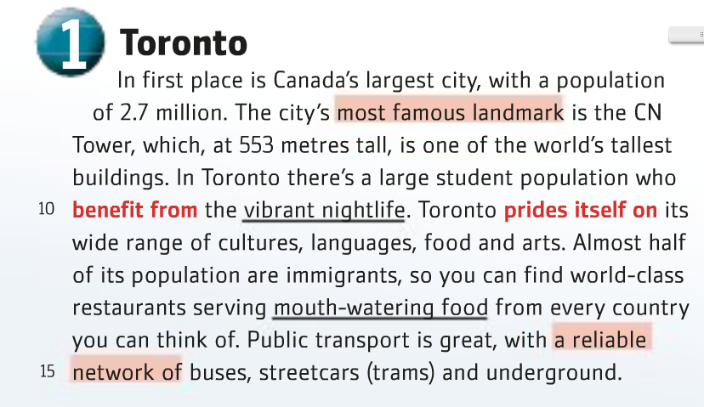

Slide 6
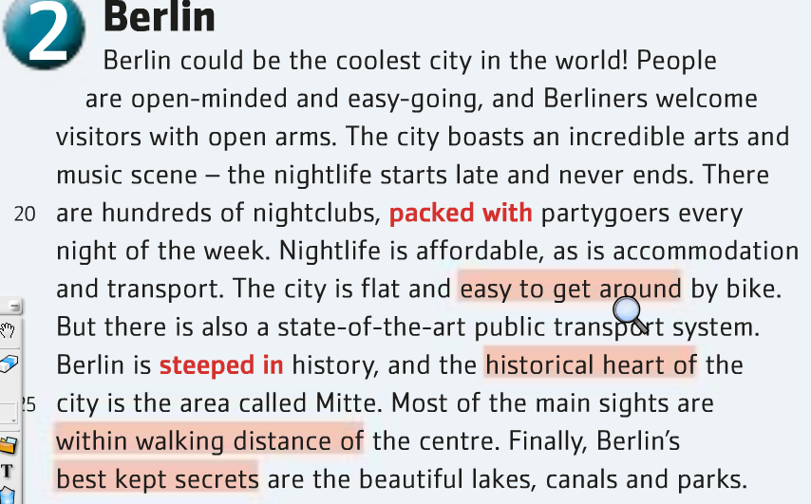

Slide 7
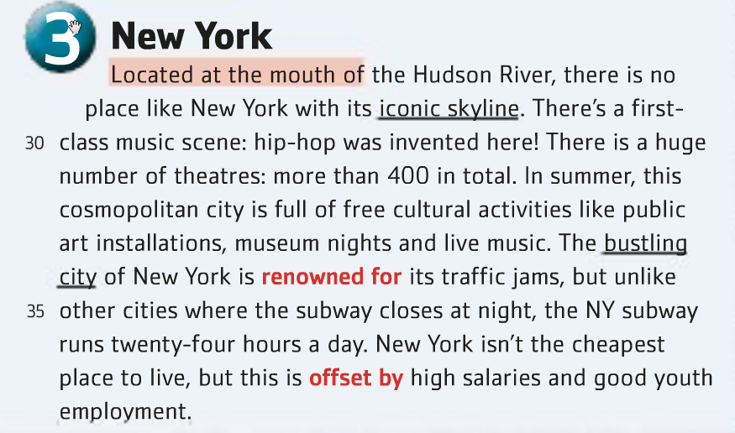

Slide 8
PREPOSITIONS
VERBS and PREPOSITIONSA dependent preposition is a preposition that always follows the same expression; for example, we say ‘interested in’ (and NOT X ‘interested on‘ or ‘interested about‘X).

Slide 9
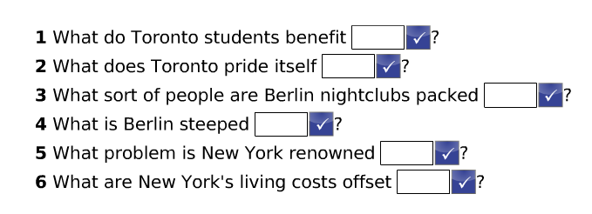

Slide 10
VOCABULARY

Slide 11
COMPLETE THE SENTENCES ABOUT PLACES IN YOUR COUNTRY

Slide 12
HOMEWORK
WORKBOOK P. 36-37

Slide 13
THANK YOU :)

