Slide 1
6. get well

Slide 2
Vocabulary
To insure – to protect yourself against risk by regularly paying a special company that will provide money if you are injured (osigurati se)
Sprain - to cause an injury to a joint (a place where two bones are connected) by a sudden movement. (uganuti, uganuće)
Cut – to break the surface of something using a sharp tool
Bruise (as noun) – an injury where the skin is darker in colour, often as a result of being hit by something (modrica); (as verb) – to develop a bruise (dobiti modricu)
Scratch ( as verb) - to damage a surface of your skin slightly with or on something sharp or rough (ogrebati se); (as noun) – a mark made by scratching (ogrebotina)
Burn – injury caused by fire of extreme heat, or to cause this to happen (noun – opekotina; verb – opeći se)
Dislocate – to force a bone suddenly out of it’s correct position (iščašiti)

Slide 3
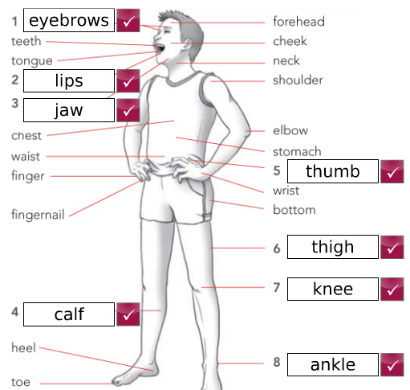
Parts of the body

Slide 4
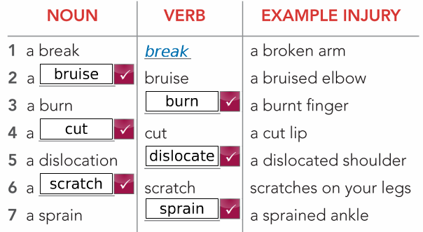
Word families - injuries

Slide 5
Body idioms

