Slide 1
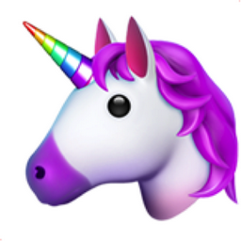
Information Technology
(IT)

Slide 2
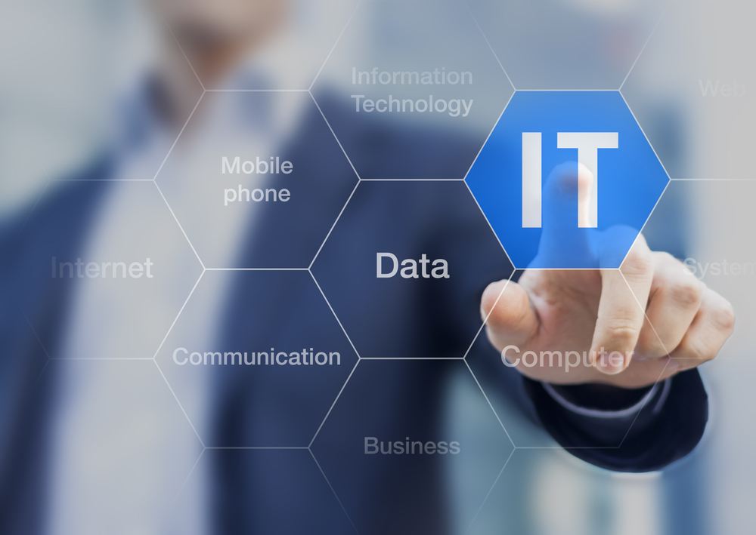
What is IT?
IT is the application of computers to store, retrieve, transmit and manipulate data ,or information.
IT is considered to be a subset of information and communications technology.
As defined by Information Technology Association of America (ITAA) “IT” is the study, design, development, implementation, support or management of computer based information system particularly software’s applications and computer Hardware

Slide 3
History of IT
There are 4 main ages that divide up the history of information technology.
Only the latest age (electronic) and some of the electromechanical age really affects us today.
Those ages are:
Premechanical (between 3000 B.C. and 1450 A.D.)
Mechanical(between 1450 and 1840)
Elektromechanical ( between 1840 and 1940)
Elektronic (from 1940 and onwards)

Slide 4
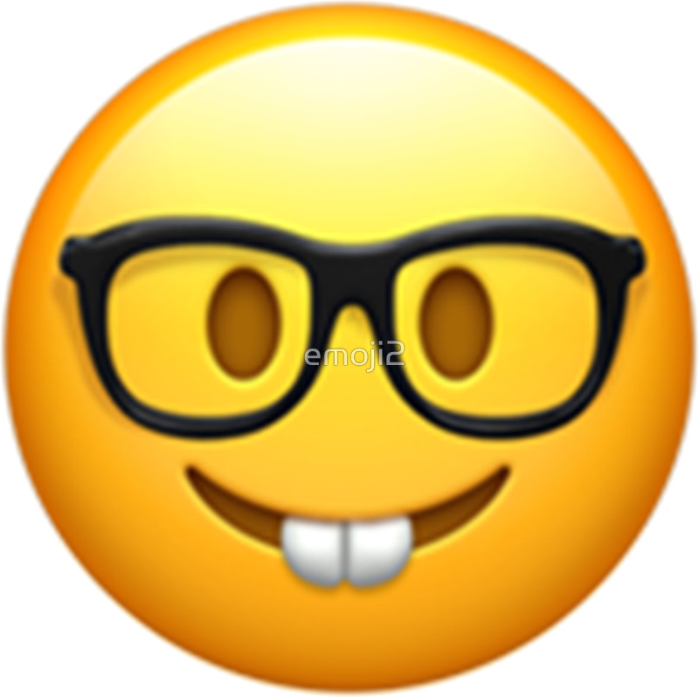
Electronic age
There are 4 main sections of digital computing.
The FIRST was the era of vacuum tubes and punch cards like the ENIAC and Mark 1.
The ENIAC was the first high-speed, digital computer capable of being reprogrammed to solve a full range of computing problems.
This computer was designed to be used by the U.S. Army for artillery firing tables.

Slide 5
Electronic age
The SECOND generation replaced vacuum tubes with transistors, punch cards were replaced with magnetic tape, and rotating magnetic drums were replaced by magnetic cores for internal storage.
Also during this time high-level programming languages were created such as FORTRAN and COBOL.

Slide 6
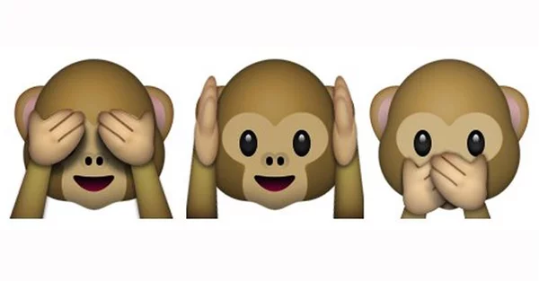
Electronic Age
The THIRD generation replaced transistors with integrated circuits, magnetic tape was used throughout all computers, and magnetic core turned into metal oxide semiconductors.
An actual operating system showed up around this time along with the advanced programming language BASIC.

Slide 7
Electronic Age
The FOURTH and latest generation brought in CPUs (central processing units) which contained memory, logic, and control circuits all on a single chip. The personal computer was developed (Apple II)
The graphical user interface (GUI) was developed.

Slide 8
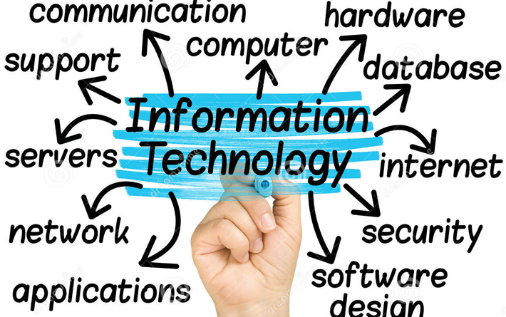
How important is IT?
IT is crucial in education, finance, healthcare, security, business AND LITERALLY EVERYTHING ELSE!

Slide 9
Advantages
With improvements in information technology, globalization has increased. The world is brought closer, and the world’s economy is quickly becoming a single interdependent system. Information can be shared quickly and easily from all over the glob, and barriers of linguistic and geographic boundaries can be torn down as people share ideas and information with each other.
Communication has become an easier, cheaper, and faster system with the help of information technology. Using the internet, people can speak to each other all over the world using video conferencing.
Information technology has also created new jobs. Programmers, systems analyzers, hardware and software developers, and web designers all owe their jobs to information technology. Without such advances, these jobs would not exist.

Slide 10
Disadvantages
Although information technology continuously works on making things more secure, there is still a great lack of privacy. Cell phones have been known to be intercepted, and email addresses can be hacked.
It is also believed that along with opening a great communication window, information technology has begun to create a dominant culture. Many believe that the United States holds the most influence over how teenagers all over the world now act, dress, and behave simply because of what they can access online. English has slowly become the primary mode of communication for business and other communication areas.
Many people also credit information technology with a lack of job security. As new technology is released and jobs require more and more training, it’s important for employees to stay in a learning mode in order to keep their job. Changes in technology make it difficult for older employees to adapt as quickly as their younger peers.

Slide 11
Some random facts, found online
Your fingers travel more than 12 miles on an average working day by typing.
Email is quite older than the World Wide Web.
The very first banner ad was used in the seemingly close, yet insanely far 1994.
One out of every eight marriages in the US was held by couples who’ve met online.

Slide 12
The science of today, is the technology of tomorrow.

